Slide 1
Poomsae Seminar
USATKD Referee Development Program
Rev. 10 1/1/2020
Notes:
NOTE: Add location and date of seminar in the box provided.
Revision PP-DR-1: 3/25/12
Updated to include new information in latest WTF & USATKD rules: Change of Division names, change of tie breaker procedure.
Revision 4 (1/21/13)
Updated divisions and made other changes to bring into line with latest WTF Competition Rules.
Revision 5 (1/22/13)
Minor edits.
Revision 6 (2/14/13)
Minor edits.
Revision 7 (1/28/14)
Updated divisions and made other changes to bring into line with latest WTF Competition Rules.
Revision 8 (3/1/15)
Minor edits.

Slide 2
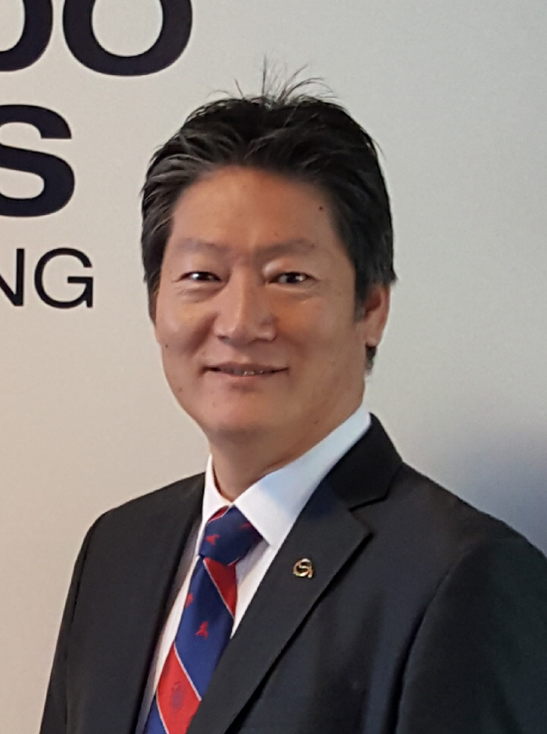
Your Referee Development Team
USATKD Referee Chair
  Seung Hwan Kim
  USATreferee@gmail.com
USATKD Referee Services Manager
  Alyssa Allen
  Referees@usa-taekwondo.us

Slide 3
Today’s Schedule
Rules
  Poomsae
  Demonstration Team
  Breaking
Basic Movements
Poomsae Details ~video clips
Scoring Practice ~video clips

Slide 4
Rules Presentation
Duties of a Referee
Basic Poomsae Rules
Recognized Poomsae
  Accuracy
  Presentation
Freestyle Poomsae
  Required Techniques
Demonstration Team
Breaking

Slide 5
Poomsae Seminar
USATKD Referee Development Program
Duties of a Referee

Slide 6
Referee Development Program
Mission
  To develop USATKD Referees at all levels through education, standardization and practical application
  To certify and promote referees using a systematic approach based on participation and merit
  To ensure a fair competition environment for athletes in pursuit of competitive excellence

Slide 7
Basic Principles
From WT’s Foundations of Refereeing:
  There are general principles which the referee in any sport must fully understand and adhere to:
  Protect the physical safety and the trust of the competitors
  Protect the integrity of the competition process

Slide 8
Remember These Three Fundamentals!
Safety
Fairness
Common sense
“The rules are your tools”
  Know the rules
  Apply the rules fairly and consistently
  If it’s not in the book, use common sense

Slide 9
Poomsae Judging Proficiency
To become a competent poomsae judge, you have to:
  Know (not necessarily perform) the correct execution of all basic techniques, moves and stances
  Know the correct order of techniques for each poomsae
  Understand the correct timing, rhythm and phrasing of the movements and pooms of each poomsae
  Independently study all of the above in published texts, videos and online resources

Slide 10
Game Day!
Dressed for the occasion
  Black suit, white dress shirt, red tie
  White TKD or athletic shoes
  No watches or jewelry in the ring
Well-groomed
  No jeans
  Shirt tucked in
Well-rested — no late-nights until after the event
On time — even better, early
No talking or texting on cell phones while in the ring!

Slide 11
Referee Duties
Referee
  Document all valid points
  Issue Kyeong-go’s
Judges
  Document all valid points
Competition Coordinator
  Direct the flow of the matches
  Declare the winner
Scorekeeper
  Operate the computer & timers

Slide 12
Poomsae Seminar
USATKD Referee Development Program
Basic Poomsae Rules

Slide 13
Contest Area
Matted section is called the Contest Area
  10m x 10m
    Exception: Freestyle Mixed Team is 12m x 12m
  USATKD-approved mats only
  Must provide safe, secure footing for the competitors

Slide 14
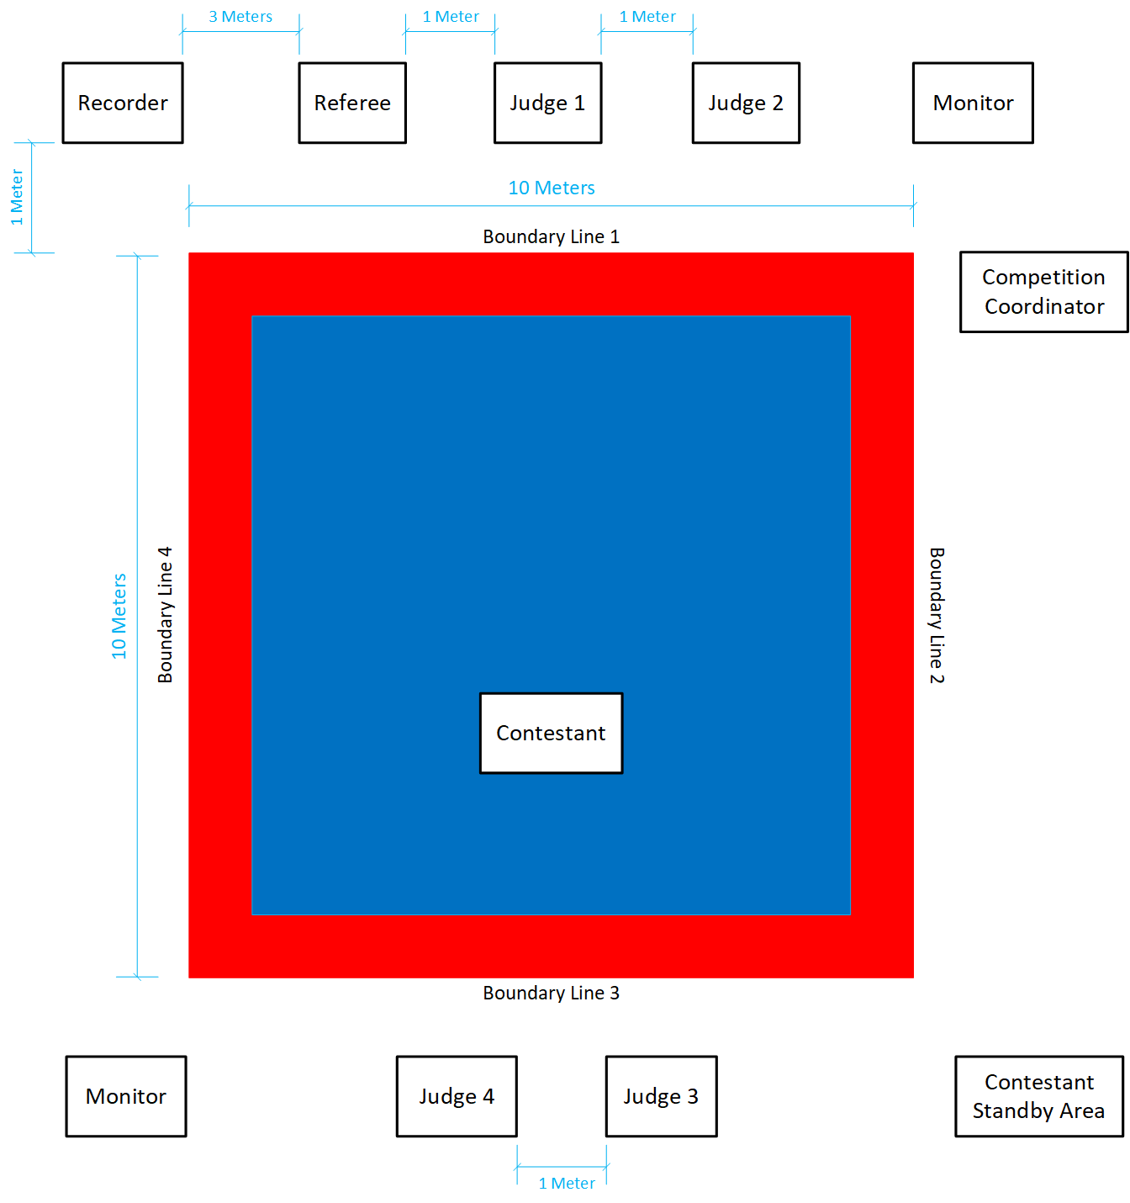
Contest Area
Notes:
Rec: Recorder
R: Referee
J1, 2, 3, 4, 5, 6 Judge
C1: Competition Area
C2: Contestants
C3: Standby Area for Contestants and Coach
C4: Competition Coordinator
1, 2, 3, 4 Boundary Lines

Slide 15
Uniform
Contestants must wear either:
  White Taekwondo V-neck
  WT approved Poomsae competition uniform
Color Belts must wear white collared uniforms
Black Belts must wear black collared uniforms
  If poom collar is worn, then poom belt must be worn by Under 15
Belt must match division
  Yellow, Green, Blue, or Red for Color Belts
    Red belts must wear solid red, not red & black
  Black for Black Belts
    Poom Belts may only be worn by under 15 Black Belts

Slide 16

WT Poomsae Uniforms
Male
Female
Male
Female
Male & Female
Cadet
Junior Under 30
Under 40 Under 50
Under 60
Under 65
Over 65

Slide 17
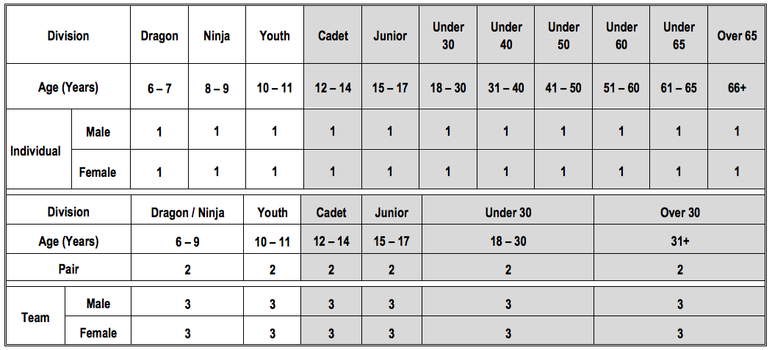
Poomsae Divisions: Recognized
Shaded cells = official WT divisions
Unshaded cells = USATKD divisions

Slide 18
Poomsae Divisions: Freestyle
Division |  | Under 17 | Over 17
Age |  | 12–17 years old | 18 years old and over
Individual | Male | 1 | 1
 | Female | 1 | 1
Pair |  | 2 | 2
Team (Mixed) |  | 5 (plus 1 substitute, maximum) | 5 (plus 1 substitute, maximum)
Shaded cells = official WT divisions
Unshaded cells = USATKD divisions

Slide 19
Poomsae Divisions: Mixed
Division |  | Over 17
Age |  | 18 years old and over
Individual | Male | 1
 | Female | 1
Pair |  | 2
Team | Male | 3
 | Female | 3
Team (Mixed) |  | 5 (plus 1 substitute, maximum)
Performs one Freestyle Poomsae and one Recognized Poomsae
Shaded cells = official WT divisions
Unshaded cells = USATKD divisions

Slide 20
Methods of Competition
Single elimination
  Competitor is eliminated from competition after one loss
Cut-off
  Competitors all compete, with only the highest scoring moving onto the next round
Combination System: Cut-off + Single elimination
  Preliminary & Semi-Final are Cut-off
  Final is Single Elimination

Slide 21
Cut-Off Tournament Format: Recognized
Maximum of three rounds
    Preliminary round
    Semi-final round
    Final round
    20 or more competitors, competition starts from preliminary round
    9 to 19 competitors, competition starts from semi-final round
    8 or fewer competitors, competition starts from final round

Slide 22
Cut-Off Tournament Format: Freestyle
Maximum of two rounds
    Semi-final round
    Final round
    13 or more competitors, competition starts from semi-final round
    12 or fewer competitors, competition starts from final round

Slide 23
Cut-Off Tournament Format, cont.
Preliminary round
  Each contestant performs one or two assigned forms
  Scores are totaled
  Top 50% advance to the semi-final round
    If an odd number, round up (e.g., with 23 contestants, round up to 24, and 12 contestants advance to semi-final round)
Semi-final round
  Each contestant performs one or two assigned forms
  8 (Recognized) or 12 (Freestyle) contestants advance to the final round
Final round
  Each contestant performs two assigned forms
  Top 4 contestants receive medals

Slide 24
Cut-Off Tournament Format, cont.
For each round, poomsae are randomly assigned from the WT list of Compulsory Poomsae for each division
  Assignment is done in advance of the competition, and publicized for competitors
Order of competitors is randomly determined for the start of the preliminary and semi final rounds
The final round order shall be determined by the placement in semi final by lower score to higher score
    For preliminary round, division may be split into groups, with each group judged by different judges
The top four contestants / pairs / teams are
awarded prizes
  3rd and 4th places receive bronze medals

Slide 25
Duration of Contest
Recognized Poomsae
  Up to 90 seconds
  Individual, Pair and Team
Free Style Poomsae
  90 – 100 seconds
  Individual, Pair and Mixed Team
Waiting time between Poomsae
  Minimum of 30 seconds

Slide 26
Decision and Declaration of Winner
Final score is the average of the scores for Accuracy plus the average of the scores for Presentation
  The highest and lowest scores are dropped before calculating the average
  If using the three judge format, the highest and lowest score will not be dropped
Scoreboard shows the score for Accuracy, Presentation and the Total Score
    Penalties, if any, are deducted from the final score

Slide 27
Decision and Declaration of Winner
In any round, the winner is the contestant with the highest total points
In case of a tie, the winner is decided based on:
  Presentation in Recognized Poomsae
  Technical in Freestyle Poomsae
  Freestyle in Mixed Poomsae
If still tied, the dropped high and low scores are added back in
If still tied, a rematch is conducted
  The rematch consists of one compulsory Poomsae designated by the Tournament Committee
  In case of tie, the highest point total with high and low scores added in shall be the winner

Slide 28
Kyeong-go Penalties
The Referee declares any penalties for prohibited acts
Kyeong-go penalties include:
  Uttering undesirable remarks or any misconduct on the part of a contestant or a coach
  Any act that intentionally interferes with another competitor, coach or official
If a competitor is assessed two Kyeong-go deductions, they are declared loser on penalties

Slide 29
Yellow Card Procedure
Only the Center Referee may give a Yellow Card
  Other referees may advise the Center Referee to give a Yellow Card
First, Kyeong-go for misconduct should always be given before the Yellow Card is shown
If the bad behavior continues, the referee gives a second Kyeong-go, and raises a Yellow Card
For extreme misconduct, referee may raise the Yellow Card after giving the first Kyeong-go

Slide 30
Yellow Card Procedure: Post Match
The Center Referee fills out the Yellow Card Report
  Any other referee who advised on the Yellow Card must also contribute to the report
The Yellow Card Report is given to the Referee Chair for review
The Tournament Committee convenes an Extraordinary Sanctions Committee (ESC)
  5 members: Referee, Coach, Athlete, Tournament Committee, Technical Delegate/Official
The Referee and other involved parties are called by the ESC to give a report and answer questions
The ESC makes a recommendation on sanctions
USATKD makes a final decision on sanctions based on the ESC report.

Slide 31
Poomsae Seminar
USATKD Referee Development Program
Recognized Poomsae

Slide 32
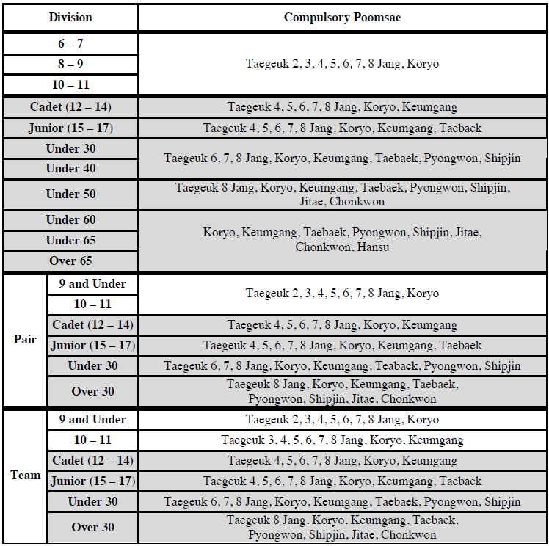
Compulsory Poomsae (Black Belts)

Slide 33
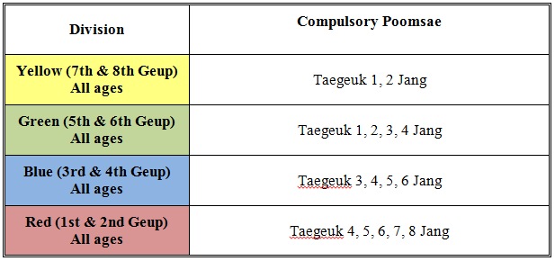
Compulsory Poomsae (Color Belts)

Slide 34
Principles of Sport Poomsae
Low (“arae”) is below the waist
  Blocks and strikes to this area should start from above the shoulder
Middle (“momtong”) is between the waist and the top of the shoulders
  Blocks and strikes to this area should start from between the eyes and waist.
High (“olgul”) is above the shoulders to the top of the head
  Blocks and strikes to this area should start at or below the waist

Slide 35
Principles of Sport Poomsae
Outside to inside techniques end at the centerline of the body
    Middle block (inside block)
    Reverse knife hand strike
Inside to outside techniques end at the outer edge of the body
    Side blocks (outside block)
    Knife hand guarding block (single or double)
Blocks are performed with the blocking hand on the outside
Strikes are performed with the striking hand on the inside

Slide 36
Principles of Sport Poomsae
All poomsae begin and end in about the same spot (within one foot’s length)
  Exception may be made for Keumgang and Jitae
Audible breathing or hissing results in a deduction
  In general, breathe in through the nose and out through the mouth
The feet should not move in an inward-to-outward “swinging” motion
The head should remain level and not bob up and down between stances

Slide 37
Principles of Sport Poomsae
In stances, the knee is bent to just cover the tip of the toes (from the competitor’s perspective)
Kicking is always to a realistic target
  First choice is to the head — area between the nose and mouth
  Second choice is to the body — the solar plexus
  In some Poomsae, a specific other target is defined; for example:
    Low side kick in Koryo, or double front kicks in Taegeuk 8

Slide 38
Principles of Sport Poomsae
Fists should remain closed (or open) during the entire movement
The fist and wrist should be straight — not bent up or down
Hands and feet should complete their movements at the same time
Transitions between movements should be on the balls of the feet

Slide 39
Scoring Criteria
 | Details of Scoring Criteria | Points
Accuracy (4.0 Points) | Accuracy of details of each Poomsae | 4.0
 | Accuracy of basic movements
 | Balance
Presentation (6.0 Points) | Speed and power | 2.0
 | Rhythm & Tempo | 2.0
 | Expression of energy | 2.0

Slide 40
Scoring Criteria
Accuracy is scored as the competitor performs the Poomsae
Presentation criteria are scored after the completion of the Poomsae
  This is similar to the “old way” — but don’t include accuracy errors, as they have already been penalized

Slide 41
Poomsae Score Sheet
Competitor: |  |  |  | Ring #: |  |  |  | Round: Preliminary Semi-Final Final
Division:
Judge's Name: |  |  |  | Signature: |  |  |  |  |  |  |  |  |  | Date:
Poomsae #1:
Accuracy (4.0) | Accuracy in Basic movements | Add deductions, subtract from 4.0. Record Accuracy score is Score box (Use / for 0.1 & ( ) for 0.3). |  |  |  |  |  |  |  |  |  |  |  |  |  |  |  | Score
 | Accuracy in Individual Movements of Poomsae
 | Balance
Presentation (6.0) | Power & Speed | 2.0 | 1.9 | 1.8 | 1.7 | 1.6 | 1.5 | 1.4 | 1.3 | 1.2 | 1.1 | 1.0 | 0.9 | 0.8 | 0.7 | 0.6 | 0.5
 | Coordination of Rhythm & Tempo / Softness & Power | 2.0 | 1.9 | 1.8 | 1.7 | 1.6 | 1.5 | 1.4 | 1.3 | 1.2 | 1.1 | 1.0 | 0.9 | 0.8 | 0.7 | 0.6 | 0.5
 | Expression of Energy | 2.0 | 1.9 | 1.8 | 1.7 | 1.6 | 1.5 | 1.4 | 1.3 | 1.2 | 1.1 | 1.0 | 0.9 | 0.8 | 0.7 | 0.6 | 0.5
 | Total Presentation
 | Total Accuracy + Presentation (10.0)

Slide 42
Scoring Criteria: Accuracy
Accuracy accounts for 40% of the total score
  Subtract 0.1 for minor errors
    Use a slash mark ( / ) to indicate each error
    “Correct technique performed incorrectly”
      Bent wrist, sloppy stance, slight imbalance etc.
  Subtract 0.3 for severe errors
    Use an “O” to indicate each error
    Major mistakes in execution
      No Kiyap, extra Kiyap, extra technique, incorrect technique, looking the wrong direction, not returning to starting point (except Keumgang, Jitae), etc.

Slide 43
Examples of Minor Deductions
– 0.1 minor deductions for technical
  Incorrect angle of feet in stances
  Poor chamber or recoil of kicks
  Blocking past midline of body (when midline is the target)
  Incorrect motion (for correct technique)
  Slightly poor balance (if it affects the accuracy of the movement)
  Kicking with wrong part of foot
  Hand wrapped around elbow strike (fingers should be straight)
  Incorrect thumb placement

Slide 44
Examples of Minor Deductions
– 0.1 minor deductions for technical
  Incorrect number of motions (dongjak) in one sequence (poom)
  Stance and hand technique do not finish at the same time
  Blocking / striking not at the realistic target height (e.g., groin, solar plexus, philtrum)
  Blocking motion starts on inside of opposite arm rather than outside
  Striking motion starts from outside of opposite arm rather than inside

Slide 45
Examples of 0.1 Deductions
Important! Every minor mistake is
a – 0.1 deduction
  No maximum deduction for the same error
Deductions for presentation (what to consider while formulating score)
  Slight hesitations
  Lack of rhythm
  Lack of alternating relaxation and tension
  Lack of flexibility and grace
  Incorrect or unkempt uniform

Slide 46
Examples of Major Deductions
– 0.3 major deductions for technical
  Wrong or omitted movement
  Missed Kiyap or Kiyap at the wrong movement
  Ending position differs from the starting position by more than a one foot
    Exceptions: Keumgang, Jitae
  Unnecessary foot noise in stance or stepping
  Confusion or pausing for more than 3 seconds during performance
  Stamping movement performed without enough power and sound

Slide 47
Examples of Major Deductions
– 0.3 major deductions for technical
  Looking in the wrong direction
  Significant loss of balance in performing a movement

Slide 48
Examples of Major Deductions
Major deductions for presentation (what to consider while formulating score)
  Eye focus or breathing not corresponding to the movement of motion
  Lack of fluency in movement
  Movements show lack of flexibility
  Lack of energy or force

Slide 49
Other Major Deductions
Crossing the boundary line (– 0.3)
Exceeding the time limit (– 0.3)
  These should be determined by the recorders’ table
    Referee may bring any such violations to recorder’s attention
    These deductions are taken off the final form score
Restart (– 0.6)
  Forgive any accuracy mistake before restarting, then take –0.6 off from accuracy
    i.e., After restarting, accuracy score should start with 3.4.

Slide 50
Slow Movements - 5 seconds movements
Poomsae | Stance | Action
Taegeuk 6 Jang | Naranhi seogi | Arae hecho makki
Taegeuk 7 Jang | Moa seogi | Bojumeok
Keumgang | Naranhi seogi | Arae hecho makki
Pyongwon | Naranhi seogi Naranhi seogi | Sonnal arae hecho makki Tongmilgi
Shipjin | Naranhi seogi Dwitkubi-Apkubi Apkubi Juchum seogi Juchum seogi | Hwangso makki Fist opened twisting inward, Pyonsonkkeut opeo tzireugi Bawimilgi Sonnal arae hecho makki Arae hecho makki (straightening)
Chonkwon | Moa seogi Dwitkubi Beom seogi | Nalgae pyogi Sonnal wesantul makki Taesanmilgi

Slide 51
Slow Movements - 8 seconds movements
Poomsae | Stance | Action
Taegeuk 8 Jang | Apkubi | Dangkyo teok jireugi
Keumgang | Hakdari seogi | Keumgang makki
Jitae | Apkubi Dwitkubi Apkubi | Olgul makki followed by momtong baro jireugi Momtong bakkat makki Olgumakki

Slide 52
Scoring Criteria: Presentation
Presentation accounts for 60% of the total score
  2.0 is perfect, not realistically attainable
  (so don’t use it)
  Guideline: Think of 1.4 as an average score for a world class competitor for each category
    1.7 – 1.9 Excellent
    1.4 – 1.6 Very Good
    1.1 – 1.3 Good
    0.8 – 1.0 Fair
    0.5 – 0.7 Poor
  Circle the score for each of the three categories

Slide 53
Coordinator Procedure
One Poomsae
Two Poomsae
Single Elimination

Slide 54
Poomsae Seminar
USATKD Referee Development Program
Freestyle Poomsae

Slide 55
Freestyle Poomsae
Duration:
  90 – 100 seconds
Competition area:
  Individual and Pair: 10m x 10m
  Mixed Team: 12m x 12m
Must perform with music
  No music: Disqualification
  No words allowed
    If it has words: Disqualification

Slide 56
Freestyle Poomsae Scoring Criteria
Scoring Criteria | Details of Scoring Criteria |  | Points
Technical Skills (6.0) | Level of difficulty of foot techniques (5.0) | Jumping side Kick | 5.0
 |  | Multiple kicks in a jump
 |  | Gradient of spins in a spin kick
 |  | Kyorugi style consecutive kicks
 |  | Acrobatic kicking technique
 | Basic Movements & Practicability |  | 1.0
Presentation (4.0) | Creativeness |  | 4.0
 | Harmony
 | Expression of energy
 | Music and choreography
Maximum Points |  |  | 10.0

Slide 57
Jumping Side Kick
  Must be performed by entire team
  Scoring Guideline
    0.3 – 0.5 Kick line below the belt
    0.5 – 0.7 Kick line chest level
    0.7 – 0.9 Kick line collarbone and higher
  When is it a 0?
    Land before kick is performed
    Jump Side Kick not preformed by all team members
      For Pairs and Team only

Slide 58
Multiple Kicks in a Jump
  Jumping front kick
  Scoring Guideline
    0.3 – 0.5 3 Kicks
    0.5 – 0.7 4 Kicks
    0.7 – 0.9 5 or more Kicks
  When is it a 0?
    Any kick except Ap Chagi
    Fewer than 3 kicks above the waist with 80% extension

Slide 59
Gradient of spins in a spin kick
  Jump spinning kick
  Scoring Guideline
    0.3 – 0.5 360 – 540 degree Kick
    0.5 – 0.7 720 degree Kick
    0.7 – 0.9 900 degree or more Kick
  When is it a 0?
    If there is no spin in the air

Slide 60
Kyorugi Style Consecutive Kicks
  Must start with 3-5 bouncing steps
  Scoring Guideline
    0.3 – 0.5 Poor performance
    0.5 – 0.7 Average performance
    0.7 – 0.9 Excellent performance
  When is it a 0?
    Missing 3-5 bounces before the Kyurogi style consecutive kicks

Slide 61
Acrobatic Kicking Technique
  Horizontal axis of rotation
  Scoring Guideline
    0.3 – 0.5 Poor performance
    0.5 – 0.7 Average performance
    0.7 – 0.9 Excellent performance
  When is it a 0?
    Not a horizontal axis of rotation
    No kick in the direction of rotation
    Hands touch the floor

Slide 62
Mandatory Stances
Back stance (Dwitkubi)
Tiger stance (Beom seogi)
Crane stance (Hakdari seogi)
May perform in any part of the routine
May perform in any order
Missed mandatory stance: -0.3 each

Slide 63
Other Deductions
Mandatory kicking techniques done out of order
Music under or over time -0.3
  Should be checked before the competition
Both feet out of bounds -0.3
Pair and Team
  One member preforms more than 2 techniques while another member preforms only 1 -0.3
Restart Poomsae -0.6

Slide 64
Poomsae Seminar
USATKD Referee Development Program
Demo Team

Slide 65
Demo Team Basics
The Contest Area is 12m x 12m
Each performance has three segments
  Set-up of up to 1 minute
  Performance of up to 6 minutes
  Clean-up of up to 1 minute
All props and boards must be provided by the team

Slide 66
Demo Inspection
Music is required
Contestants must wear appropriate sport attire
  This is NOT restricted to just doboks
No tables, chairs, tumbling board or any similar devices
Poles and similar devices for holding breaks must be approved in advance
No pyrotechnics, fireworks or fire
No limit to team size or composition

Slide 67
Demo Scoring Criteria
Technical Skills (6 points) | Team Form Acrobatic breaking Single jump breaking Power breaking Self-defense Basic movements & practicability of movements
Presentation (4 points) | Creativity and complexity Synchronization and harmony Taekwondo spirit Music and choreography

Slide 68
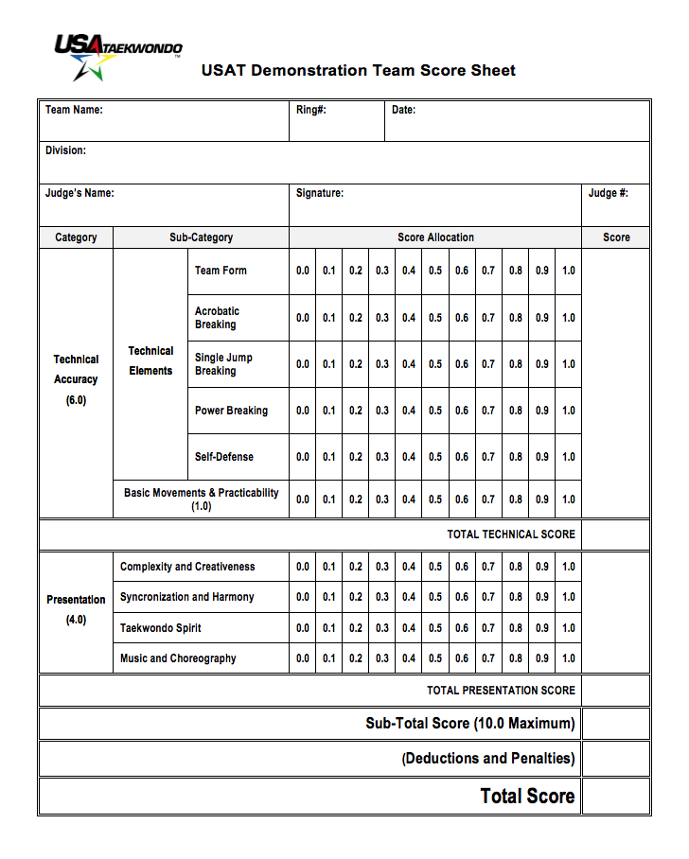
Demo Team Score Sheet

Slide 69
Demo Scoring Details
Technical skills may be performed in any order
Any element missing from a technical skill will result in a score of 0
Team Form
  Newly created Poomsae
  Includes hand and foot techniques
  All team members must perform
Acrobatic Breaking
  Kick performed while jumping in the air and rotating on a horizontal axis
  -0.1 deduction per unbroken board

Slide 70
Demo Scoring Details (continued)
Single Jump Break
  3 or more targets in a single jump
  -0.1 deduction per unbroken board
Power Break
  2 to 4 contestants must perform this skill
  Hand breaks using vertical board holders
  Three 1in x 10in x 12in pine boards per break
  -0.1 deduction per unbroken board
Self-Defense
  Empty handed
  Use of boards in this skill will result in a score of 0

Slide 71
Other Deductions
-0.1 each time a contestant steps out of bounds with both feet
-0.3 per 10 seconds or fraction thereof over any of the times for set-up, performance, or clean-up

Slide 72
Coordinator Procedure: Demo
The Coordinator gives the command “Chool-jeon”. The Recorder starts the setup timer. The team begins setup.
The Coordinator gives the command “Bah-roh”. The Recorder stops the setup timer.
The Coordinator gives the command “Char-yeot” and “Kyeong-rye”.
The Coordinator gives the command “Joon-bi”.
The music starts. The Recorder starts the competition timer.
The music stops. The Coordinator gives the command “Bah-roh”. The Recorder stops the competition timer.
The Coordinator gives the command “Shi-ah”.
The Coordinator gives the command “Tuae-jahng”. The Recorder starts the cleanup timer.
All competitors, props, and boards are no longer in the competition area. The Recorder stops the cleanup timer.
The Coordinator gives the command “Pyo-chul”. Final score is posted.

Slide 73
Poomsae Seminar
USATKD Referee Development Program
Breaking

Slide 74
Breaking Basics
Contest area 8m x 8m
Competitor has 3 minutes for set-up, performance, and clean-up
Competitor may use up to 15 boards
  6 – 9 years old: ¼ x 10 x 12 inch Demo Board
  10 – 14 years old: ½ x 10 x 12 inch Demo Board
  15 – 17 years old: 1 x 10 x 12 inch Demo Board
  18+ years old: 1 x 10 x 12 inch Pine Board

Slide 75
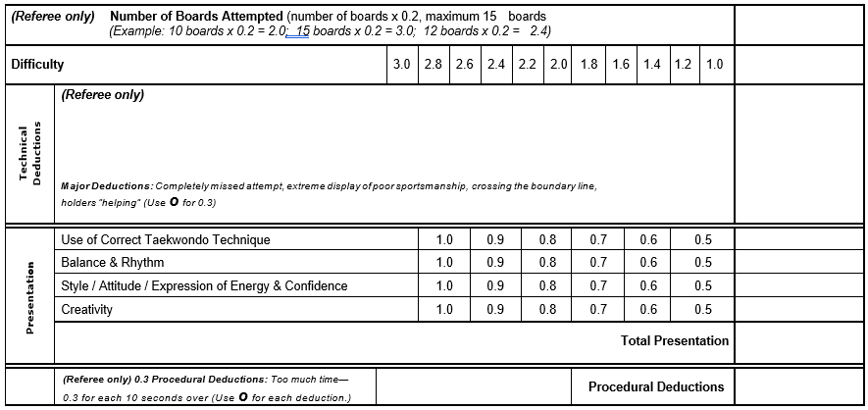
Breaking Score Sheet

Slide 76
Breaking Score Calculation
Technical Score
  The Number of Boards Attempted is 0.2 times the number of boards brought into the ring
  Add the average of the judge’s Difficulty scores, dropping the high and low if 5 judges
  Subtract all Technical Deductions scored by the Referee
Presentation Score
  Average of the judge’s Presentation scores, dropping the high and low if 5 judges
Recorder Subtracts all Procedural Deductions declared by the Referee at the end of the performance

Slide 77
Technical Deductions
-0.3 per unbroken board in an attempt
-0.3 per board brought into the ring and not attempted
-0.3 per instance of a holder bending, moving, or pushing the board
-0.1 or -0.3 for poor sportsmanship
  If excessive, this results in disqualification

Slide 78
Procedural Deductions
-0.3 Breaking with a head strike
-0.3 per 10 seconds or fraction thereof overtime
-0.3 each time a contestant steps out of bounds with both feet
  This does NOT apply to holders

Slide 79
Coordinator Procedure: Breaking
The competitor and all holders enter the contest area
“Char-yeot” (attention) & “Kyeong-rye” (bow)
“Shi-jak” starts the 3 minute timer
“Char-yeot” (attention) after cleanup
“Kyeong-rye” (bow) ends the 3 minute timer

