Slide 1
USATKD Referee Development Program Seminar
2020 Rev. 4.5, 1/1/2020
Notes:
NOTE: Add location and date of seminar in the box provided.
2017 Revision 1: 2/3/17
Reformatted and updated to correspond with latest WT and USATKD rules.
• Valid points
• Gam-jeom penalties, no more Kyung-gos
• Current Gam-jeom interpretations
• Changes to Golden point round procedure
• Changes to Video Replay procedure
• Junior Safety Rules
2017 Revision 2: 2/22/17
• Update to leg kicking section, based on reports from latest IRRC in Fujairah, 2/17 (slides 57-58)
• Update procedure for handling body shot 8-count, but no points, per Referee Chair Seung Hwan Kim (slide 92)
• Removed SHK penalties video from US Open, as WT has since changed interpretation of one of the examples
2017 Revision 2a: 2/25/17
• Fixed typo in slide #36 that indicated 2 extra points for turn to body
2017 Revision 2b: 3/5/17
• Minor language/typo fixes
• Added a new example photo in Penalties section
2017 Revision 3: 3/11/17
• Minor language/typo fixes
2017 Revision 3a: 4/3/17
• Correction to Slide #63
• Minor language/typo fixes
2017 Revision 4: 5/11/17
• Updates based on information from Acupulco IRRC
2017 Revision 5: 7/22/17
• Updates based on information from Muju World Championships—IVR procedures and waving off of PSS hits in Golden point round
• Added hand signal for excessive contact under JSRs (finger to lips, same as “unsportsmanlike conduct”)
2017 Revision 6: 10/18/17
• Updates based on information from Rabat Grand Prix
• Updated falling chart, slide #45
2018 Revision 1: 2/19/18
• Changed all references to WTF to WT
• Correction to slide #43
2018 Revision 2: 3/27/18
• Correction to slide #96 (“If a player is unable...” Removed “unwilling”)
• Addition to Slide #122 (“If referee declares a penalty but forgets to wave off points...”)
2018 Revision 3: 6/1/18
• Updated logo
• Multiple edits to align with new WT Competition Rules and instruction at Burnaby IRRC
2018 Revision 4: 6/10/18
• Added Side #65, Yellow Card Procedure, from instruction at Burnaby IRRC
2018 Revision 5: 6/12/18
• Deleted slide on random weigh-ins per instructions from Michelle Ashton of USATKD
2018 Revision 6: 6/19/18
• Changed slide 92 and #131 to reflect instruction at Croatia IRRC (referee does not play card for body kick count, but no score)
2019 Revision 2: 2/13/19
• Changes and additions resulting from discussions at the 1st Instructor Training Seminar, February 2, 2019
2019 Revision : 3/31/19
• Miscellaneous typos and minor corrections
2019 Revision: 8/11/19
Updated based on referee instructor seminar.

Slide 2
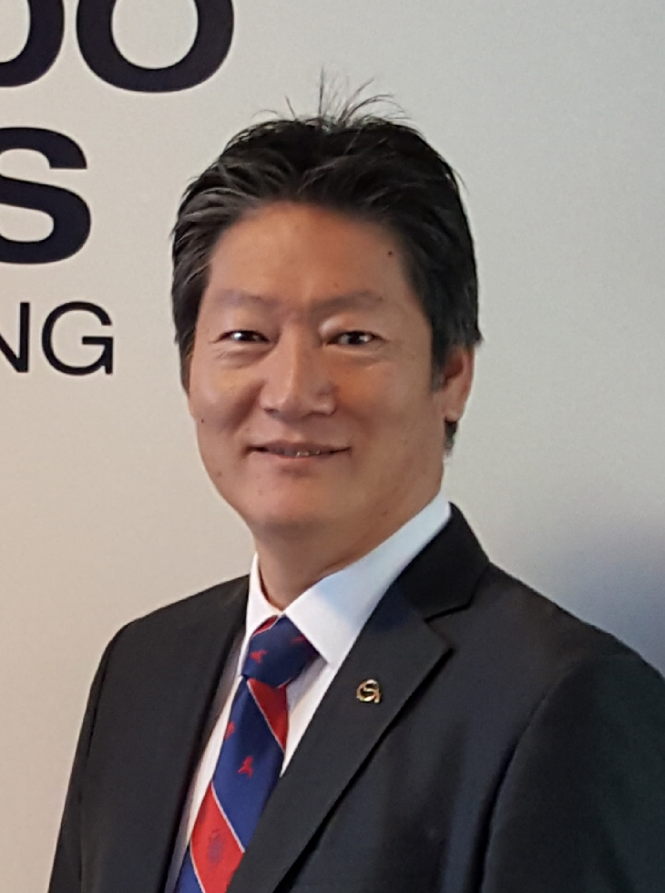
Your Referee Development Team
USATKD Referee Chair
Seung Hwan Kim
USATreferee@gmail.com
USATKD Referee Services Manager
Alyssa Allen
Referees@usa-taekwondo.us

Slide 3
Today’s Agenda
Competition Rules
USATKD Referee Development Program
Fundamentals of Refereeing
Competition Basics
Corner Judge Duties and Responsibilities
Prohibited Acts & Penalties
Referee Duties and Responsibilities
Junior Safety Rules
Technical Assistant (TA) and Ring Captain (RC) Duties and Responsibilities
Video Replay Procedure

Slide 4
Today’s Agenda
Practical
Hand Signals Practice
Scoring Practice
Match Management Practice
Questions and Answers

Slide 5
Referee Development Program
Mission
To develop USATKD Referees at all levels through education, standardization and practical application
To certify and promote referees using a systematic approach based on participation and merit
To ensure a fair competition environment for athletes in pursuit of competitive excellence

Slide 6
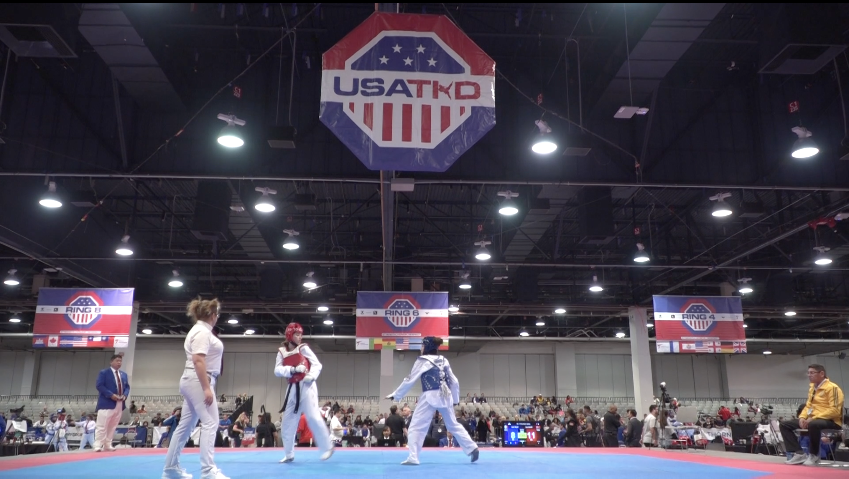
Section 1: Fundamentals of Refereeing
Notes:
New picture

Slide 7
Basic Principles
From WT’s Foundations of Refereeing:
There are general principles which the referee in any sport must fully understand and adhere to:
Protect the physical safety and the trust of the competitors
Protect the integrity of the competition process

Slide 8
What Is the Referee’s Job?
The Referee’s Number One responsibility is the safety of the competitors
If you make a mistake — and you will — always err on the side of safety
The referee is there to ensure fair play, and manage the competition fairly. This enables both players to perform at the best of their ability
Technology is there to help us “get it right”
Notes:
Talking Points:
• The referee is an integral part of the competition, and makes a tremendous difference in the quality of the event, and in the level of competition.
• At the same time, the best referee is the one who is “invisible.”

Slide 9
Remember These Three Fundamentals!
Safety
Fairness
Common sense
“The rules are your tools”
Know the rules
Apply the rules fairly and consistently
If it’s not in the book, use common sense

Slide 10
Qualities of a Good Referee
Integrity
Confidence
Decisiveness
Consistency
Calmness under pressure
Thorough knowledge of the Competition Rules
In-depth understanding of the evolving game
Wisdom and experience to apply the Competition Rules correctly
Strong sense of motivation

Slide 11
More Qualities of a Good Referee
Excellent communication skills
Ability to observe what’s happening
Respect for
Players
Coaches
Tournament staff — volunteers, medical, security, Organizing Committee
Fellow referees
Sense of teamwork
Good physical condition
Notes:
Talking Point:
• Enjoyment is also important!

Slide 12
Developing “Ring Presence”
Good physical presentation
Grooming
Attire
Attitude (see “Qualities”)
Physical poise
Posture
Balance
Graceful movement
Precise hand signals
Focus
Authoritative voice

Slide 13
Game Day!
Dressed for the occasion
Black suit, white dress shirt, red tie
White TKD or athletic shoes
No watches or jewelry in the ring
Well-groomed
No jeans
Shirt tucked in
Well-rested — no late-nights until after the event
On time — even better, early
No talking or texting on cell phones while in the ring!
Notes:
Talking Point:
• Bring your “A” game — and come to make a difference.

Slide 14

Section 2: Competition Basics

Slide 15
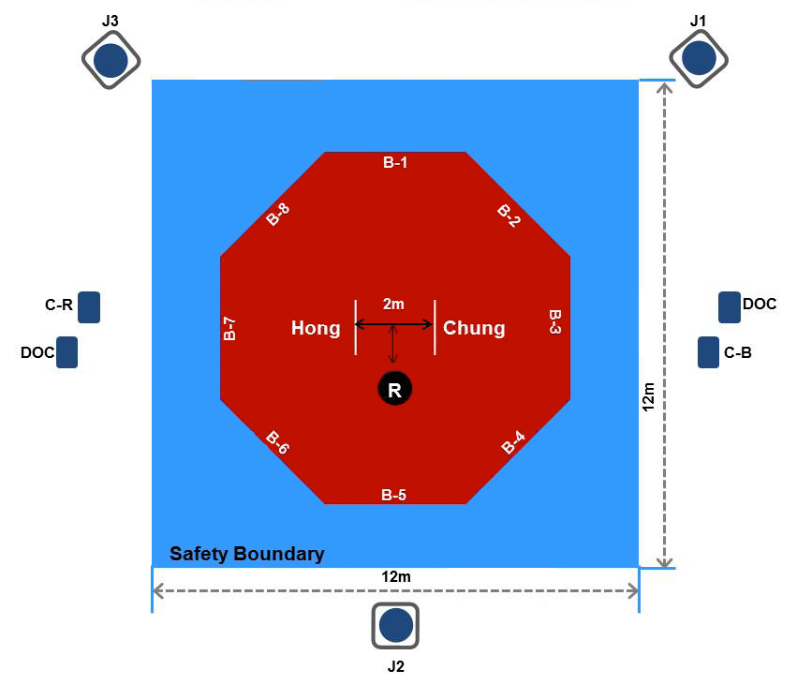
The Contest Area (Octagonal, 3 Judges)
Notes:
Talking Points:
• Octagonal shape is now being used in all major WT and USATKD competitions.

Slide 16
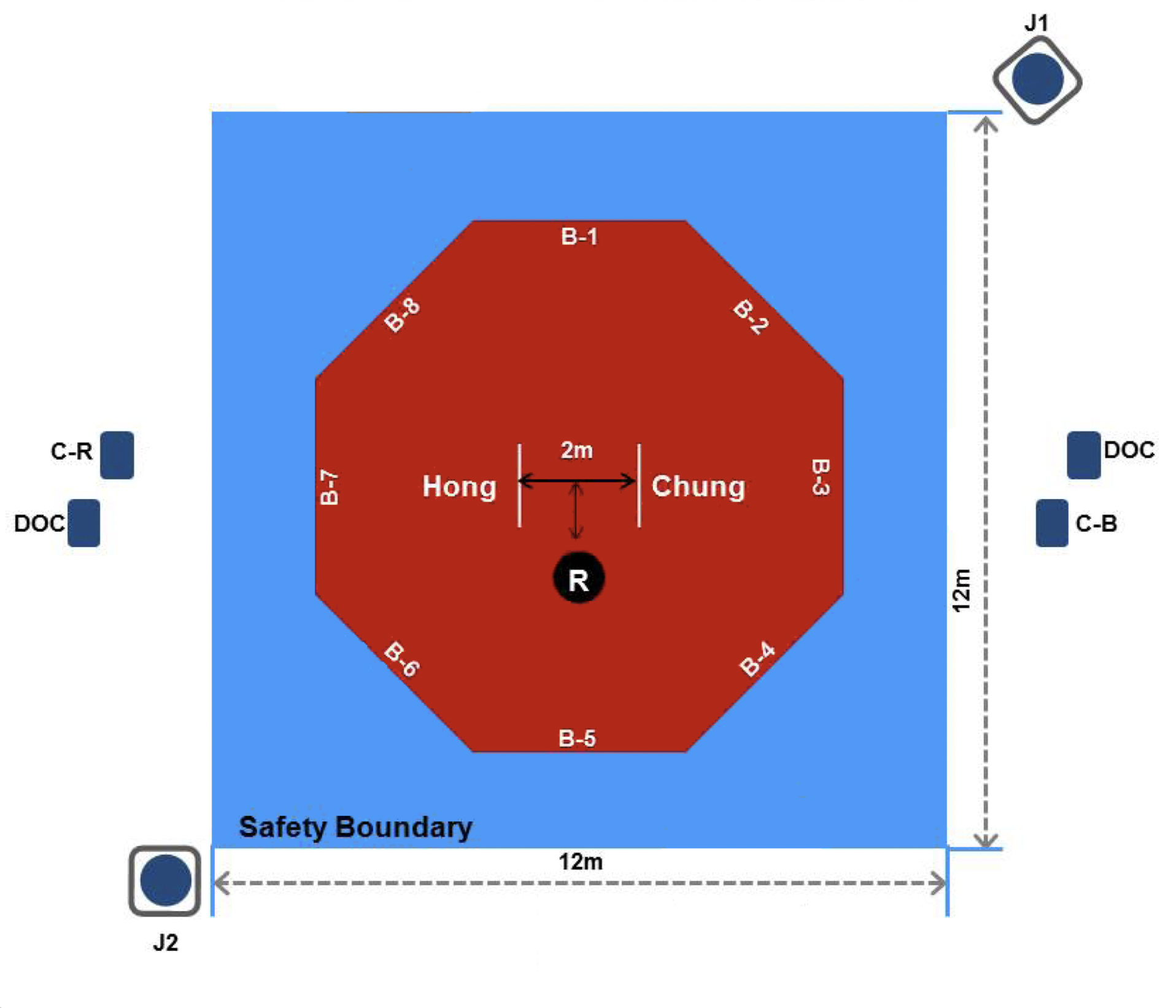
The Contest Area (Octagonal, 2 Judges)

Slide 17
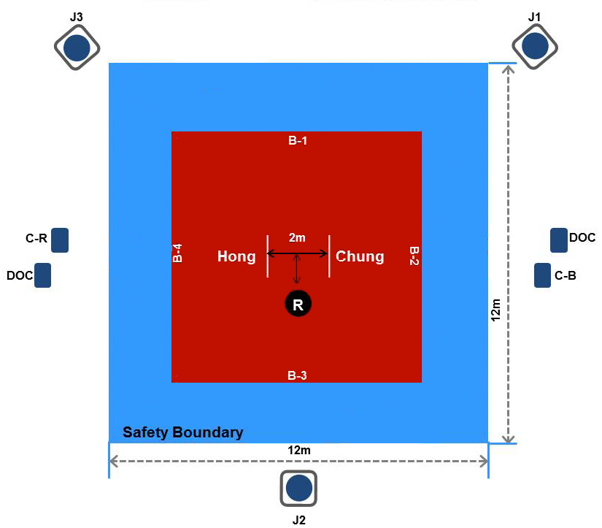
The Contest Area (Square)
Notes:
Talking Points:
• Contest Area measures 8 m x 8 m (~26 ft. x 26 ft.)
• Boundary Line marks the limit of the Contest Area
• Safety Boundary Area should be 1 m or 2 m wide
• Coaches must remain in 1 m x 1 m Coach’s Zone

Slide 18
Duration of the Contest
Three rounds of two minutes each, with one-minute rest period between rounds
The contest in each round begins with referee’s declaration of “Shi-jak” and ends with referee’s declaration of “Keu-man”
Even if the referee has not declared “Keu-man,” the contest is considered ended when the match clock expires — so be alert and call “Keu-man” on time!
Round duration and rest periods may be changed for specific competitions (i.e., shorter rounds for juniors or color belts, a single 5-minute round for team competition, etc.)
In case of a tie score at end of the 3rd round, there will be a one-minute overtime (“Golden Round”) after the rest period

Slide 19
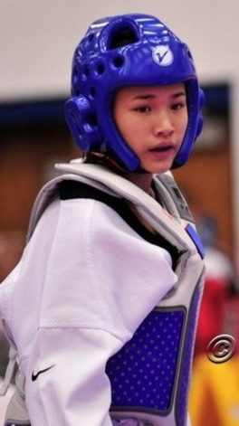
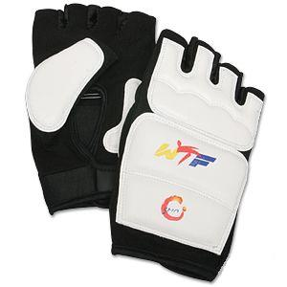
Protective Equipment
Mandatory
Head Protector (blue and red required for World Class divisions, white allowed for other divisions; if blue or red, must match Hogu)
Chest Guard
Groin Guard (male and female; worn inside Dobok)
Mouth Guard (details next slide)
Forearm Protector
Shin/Instep Protector
WT-Approved Gloves (required for World Class divisions, optional for others; white (or blue/red to match hogu), half-fingered)

Slide 20
Protective Equipment (Mouthguard)
Mouthguard
Any solid color except red
At least 3mm thickness
Night guards and Invisalign are not allowed
Contestants with upper and lower dental braces must follow one of the following:
Double mouthguard for braces
Upper mouthguard + lower mouthguard for braces (must cover at least 6 teeth)
Upper mouthguard + lower brace shield

Slide 21
Inspection
Recommend same gender inspection when possible
All mandatory protective equipment
Approved sensing socks (if using PSS)
Proper number and arrangement of magnets — use magnet tester to verify
Properly fitting chest guard (tied top to bottom)
Dobok — clean and in good repair
White V-neck
Black Belts must wear Black collared V-neck
Poom rank (15 and under Black Belts) may wear Red/Black collared V-neck
No tape on uniform
No metallic or hard plastic braces
Head protector in good repair
No cracks, tape, pictures, writing, etc.
Mouth guard

Slide 22
Inspection (continued)
Appropriate belt
White, Yellow, Green, Blue, Red, Red & Black Poom Belt, or Black
Red belts must wear solid red, not red & black
Poom Belt for 15 and under Black Belts only
Fingernails and toenails clipped
Long hair tied back so it won’t get in the way
No glasses or sport goggles — no exceptions!
No jewelry — chains, ear studs, nose or eyebrow rings, tongue studs, etc.
No metallic or hard objects in the hair
No excessive taping
No tape under PSS socks, unless by medical
No “do-rags” or anything else on head (Exception: religious head covering)
Notes:
Talking Points:
• Really check for hidden jewelry.
• No bobby pins, hair clips, etc. — no hard objects in hair.
• If using taped instep pads, must cover down to edge of toes, must be enough padding to feel squishy.
• Look for soccer-type hard shin guards under shin pads; it happens.

Slide 23
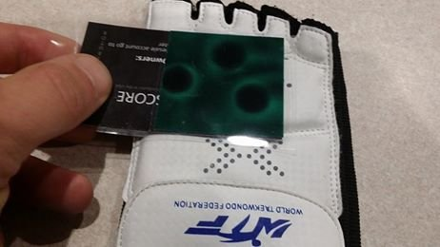
Inspection (Daedo Magnet Tester)

Slide 24
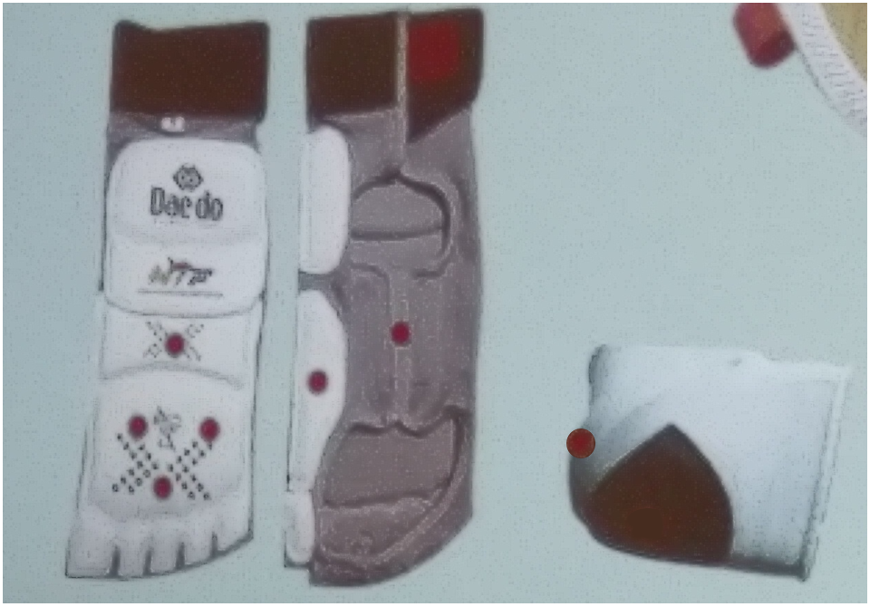
Inspection (Daedo Sock Gen 1)

Slide 25
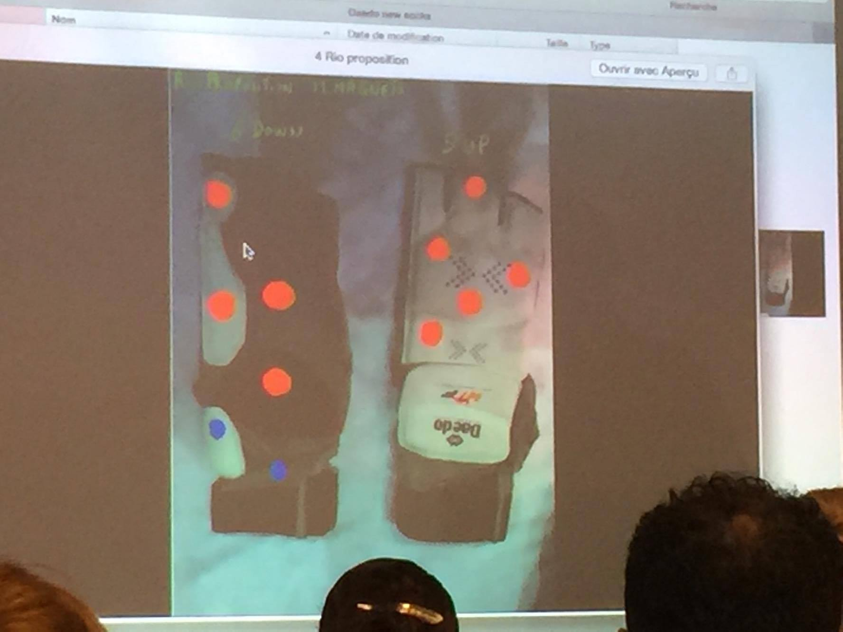
Inspection (Daedo Sock Gen 2)

Slide 26
Weigh-In Procedures
Contestants weigh-in the day prior to competition
USATKD-certified referee must do the weigh-in
Competitors allowed two tries to make weight, within the time limit
A second test scale must be provided
Contestant must show their competitor’s badge and photo ID
May be required to show proof of citizenship or residency
Under NO circumstances may an athlete weigh-in nude!
Weigh-in may be done in underpants for males, underpants and bra for females (17 and under must be clothed per SafeSport guidelines)
Separate weigh-in locations for male and female
Any taping must be removed during weigh-in
0.2 kilograms (200 grams) uniform allowance for athletes 17 and under
0.1 kilograms (100 grams) allowance for athletes 18 and over
No cast, brace, crutches, etc. that would not pass inspection
Notes:
Talking Points:
• The Weigh-In sheet is vital to the competition, and must not get into the hands of unauthorized individuals.
• Turn it over to the next referee doing weigh-in; if you’re the last one for the day, personally deliver it to the appropriate person (usually, the Referee Chair).

Slide 27
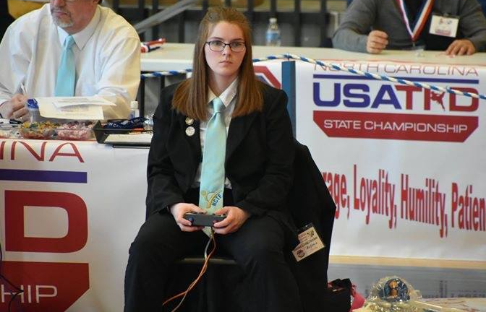
Section 3: Corner Judge Duties & Responsibilities

Slide 28
Corner Judge Duties
The judges shall score the points immediately.
The judges shall state their opinions forthrightly when requested by the referee.
Corner judges and the referee are a team, and work together to “get it right”
Corner judges should make it a habit to be aware of points scored and the accuracy of the scoreboard
Notes:
Talking Points:
• Corner judges help the center referee. Don’t second-guess the referee, but stand-up and advise if you see a problem. Examples: - No additional point awarded for turn kick
- Penalty is given to the wrong competitor
- Problem with electronic scoring system

Slide 29
Corner Judge Basics
Judges score or award technical points by pressing buttons on an electronic scoring device
Device may be in the form of individual hand grips, or a single box
A judge must clearly understand:
Criteria for a valid point (i.e., permitted techniques, and legal scoring areas)
When to award points, and when not to award points
Electronic scoring isn’t difficult—but it does take practice!

Slide 30
Look Sharp In the Corner
Sit properly — comfortable, good posture, feet on floor, no legs crossed
Focus only on your match, get “in the zone”
Standing is preferred during the rounds
Sit during the rest periods
Move around your corner to maintain a view of the action
Notes:
Talking Points:
• You work as a team; it’s good to look like a team—it looks more professional if all officials in the ring are consistent, with jackets either on or off.

Slide 31
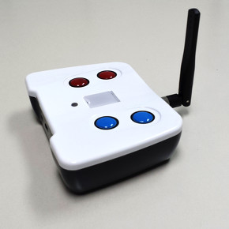
Electronic Scoring
Daedo and KPP systems are used internationally; other systems are also used
If you have two controllers
Red is ALWAYS in the left hand! Blue is ALWAYS in the right hand!
Various systems are in use; be sure to know how the system works before you go into the ring
If the system can’t accommodate it, referee stops action to award the additional point for turning kicks, technical points, etc.
Points are recorded when two of three judges press for the same player within a window of one second; if 2-judge system, both judges must agree

Slide 32
Protector & Scoring System (PSS)
Electronic Protector & Scoring Systems (PSS) — such as the Daedo system used by USATKD — automatically record points to the body (and head, if PSS headgear is used)
Corner judges press to score:
Head kicks — unless headgear PSS is used
Valid turns to the body or head
Punches
PSS must be enabled before each match
With Daedo system, this means inserting transmitters
Referees must know how to do it
Referee supervises a single test kick to verify the system is working; with headgear PSS, also one test kick to headgear, using opposite foot
Notes:
Talking Points:
• Only press for Technical point (turning kick) is kick actually touches; don’t anticipate.

Slide 33
When you make a mistake...
Everyone presses the wrong button occasionally
When you make a mistake, immediately press the correct button
If you see on the monitor that your error may have resulted in a no-score, or a score for the wrong player, stand up immediately, and call to get the referee’s attention
When one judge stands, all stand! REFEREE!
The referee will call the judges together to sort it out
When asked, state what happened (“Yes, head kick for Blue.” Or, “No, I didn’t score on that last exchange.”)
Just the facts, no involved discussion

Slide 34
Permitted Techniques
Fist techniques: A straight punching technique using the knuckle part of a tightly clenched fist
Foot techniques: Delivering techniques using any part of the foot below the ankle bone
The front part of the tightly clenched fist — no backfists, hammer fists, knife hands, ridge hands, chicken beaks, or anything other than a straight or reverse punch
Any type of foot technique is allowed
One exception: techniques with knee pointed out in clinch position (I.e., “monkey kick”)

Slide 35
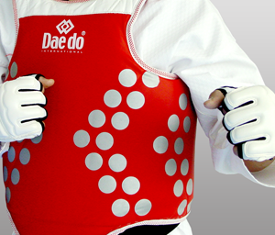
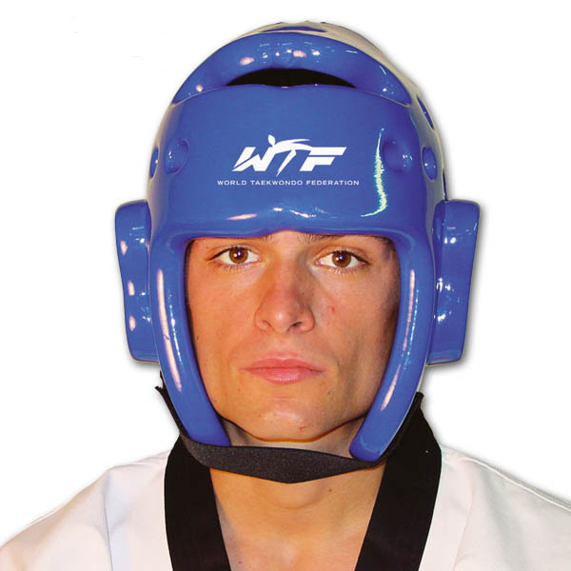
Scoring Areas
Trunk: The blue or red colored area of the trunk protector
Head: The entire head above the bottom line of the head protector

Slide 36
Permitted Areas
Trunk: Attack by fist and foot techniques on the areas covered by the trunk protector are permitted. Attack to the spine, however, is not permitted.
Head: This is the area above the collar bone. Only foot techniques are permitted.
Entire trunk protector is a legal attacking area — but only the colored area is a legal scoring area
Includes flanks, but not the spine itself
Throat or neck is not a scoring area, but is a permitted head area.
Notes:
Talking point:
• In principle, when using PSS all players must use the same size protector; however, rare exceptions can be made with the approval of the Referee Chairman.

Slide 37
When Is a Point Scored?
Points shall be awarded when a permitted technique is delivered to the scoring areas of the trunk with a proper level of impact.
Points shall be awarded when a permitted technique is delivered to the scoring area of the head.
If PSS is used, determination of the validity of the technique, level of impact, and/or valid contact to the scoring area shall be made by the electronic scoring system. These PSS determinations shall not be subject to Instant Video Replay.

Slide 38
Manual Scoring
Points are recorded when two of three judges press for the same player within a window of one second; for 2-judge system, both judges must agree
Corner judges score valid technique based on POWER and ACCURACY
In manual scoring, criteria for power and accuracy is a sliding scale — must be adjusted for the various weight classes and belt levels
Look for more power from heavyweights, less from fin weights
Look for greater power from black belts; be more generous with white or yellow belts
Head techniques: if it touches, score it!

Slide 39
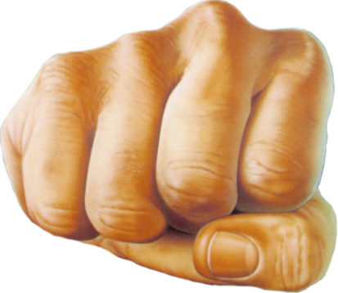
Punches
Criteria for scoring a punch
Delivering a punch using the tightly clenched, correctly made fist
Punch should be executed with extended arm
Power and accuracy

Slide 40
Valid Points
One point for a valid punch to the trunk protector
Two points for a valid kick to the trunk protector
Four points for a valid turning kick to the trunk protector
Three points for a valid kick to the head
Five points for a valid turning kick to the head
One point awarded for every Gam-jeom given to the opponent
(Turning kick to head is allowed under Junior Safety Rules, but no additional points will be given)

Slide 41
Standing to Request a Meeting
Corner judges wishing to get the attention of the center referee must stand and loudly call “Referee!” with raised hand
If a corner judge has reason to believe a head kick (if not using head PSS) has been scored incorrectly; i.e., Blue kicked and there was clear contact, but the judge pressed the wrong button
If there appears to be a technical problem
If referee has issued a penalty, but forgot to wave off points that were gained illegally
When one stands, we all stand!
The entire officiating team — including the Technical Assistant — must stand and call loudly to get the referee’s attention

Slide 42
Procedure for Missed Points
If there is a turning kick to the body or head, but no extra point has registered, judges stand up, loudly call “Referee!” and indicate the technical points by raising 2 fingers
For a missed head kick when using manual scoring, stand and raise 3 fingers, or 5 fingers for a turning kick to head
For a missed punch, stand and raise 1 finger
If you did not see the action, or do not feel points were missed, cross your arms in front of your face
These cases do not require a meeting in the center

Slide 43
Special Cases for 2-Judge System
If there is a turning kick to the body or head, but no extra point has registered, judges stand up, loudly call “Referee!” and indicate the technical points by raising 2 fingers
If judges do not stand, the referee MAY stop the match to query judges
If one judge says “Yes” and one judge says “No,” the referee will determine if technical points are to be added
For a missed head kick when using manual scoring, judges stand and raise 3 fingers, or 5 fingers for a turning kick
If judges do not stand, the referee MAY NOT stop the match
If one judge says “Yes” and one judge says “No,” the referee will determine if points for the head kick are to be awarded

Slide 44
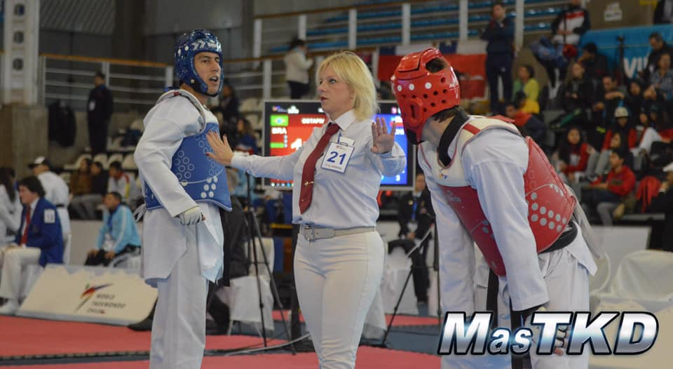
Section 4: Prohibited Acts

Slide 45
Why Do We Have Penalties?
Objectives in establishing the prohibited acts and penalties:
To secure the contestants’ safety
To ensure fair competition
To encourage appropriate techniques
The referee is not a “traffic cop.” We’re there to manage the match — not to see how many penalties we can call
“If you don’t see it, don’t call it”
Use good judgment; don’t interrupt the match unnecessarily

Slide 46
Gam-jeom Penalties
Gam-jeom penalty — results in a single point being added to the opponent’s score
Gam-jeoms are counted in the total score of the three rounds
If a player receives 10 “Gam-jeom” penalties, that player is declared loser by Referee’s Punitive Declaration (PUN)
Gam-jeom is not given if the prohibited act occurs after the referee declares Kal-yeo (except “attack after Kal-yeo” or misconduct)
In the event of a really flagrant, deliberate violation, you don’t have to wait for the penalties to add up to disqualify the competitor
When Gam-jeom is declared during the rest period, it’s applied to the previous round

Slide 47
Gam-jeom Penalties
Crossing the Boundary Line
Falling down
Grabbing the opponent
Attacking trunk PSS with the side or bottom of the foot having the knee pointed out in clinch position (“monkey kick”)
Pushing the opponent
Avoiding or delaying the match
Lifting the leg to block or/and kicking the opponent’s leg to impede the opponent’s kicking attack, or lifting a leg or kicking in the air for more than 3 seconds to impede the opponent’s potential attacking movements, or aiming a kick below the waist
Kicking below the waist

Slide 48
Gam-jeom Penalties (continued)
Attacking the opponent after “Kal-yeo”
Attacking the fallen opponent
Hitting the opponent’s head with the hand
Butting or attacking with the knee
Following misconducts of contestant or coach
Not complying with the referee’s command or decision
Inappropriate protesting of officials’ decisions
Inappropriate attempts to disturb or influence the outcome of the match
Provoking or insulting the opposing contestant or coach
Unaccredited doctor/physicians or other team officials found to be seated in the doctor’s position
Any other severe misconduct or unsportsmanlike conduct on the part of a contestant or coach

Slide 49
1. Crossing the Boundary Line
Out of bounds is defined as ONE FOOT entirely outside the Boundary Line, and on the floor
No more “vertical plane”
A foot can be outside the Boundary Line if it is off the floor; as soon as it touches outside the Boundary Line, player is out
If the player is pushed out, opposing player gets the penalty
If both players go out before Kal-yeo, both players are penalized

Slide 50
1. Crossing the Boundary Line
A player who is out of bounds CAN be scored on if the referee has not stopped the match, and time has not expired
A player penalized for Crossing the Boundary Line CANNOT score
Points scored by PSS will be removed and Gam-jeom given for out of bounds
The referee must be alert, and call “Kal-yeo” immediately when a player crosses the Boundary Line

Slide 51
2. Falling down
A player is defined as fallen when any part of the player’s body, other than the soles of the feet, touches the floor
If a contestant falls down due to the opponent’s prohibited acts, Gam-jeom is given to the opponent
If both contestants kick and fall down, or fall as a result of incidental collision (i.e., not exchanging techniques), or hard shin clash — no penalty
If only one falls, he/she receives Gam-jeom
Gam-jeom is given even if a player falls and is given an eight-count — but not if player is counted out
Rule of thumb: If player falls, give Gam-jeom, with above exceptions

Slide 52
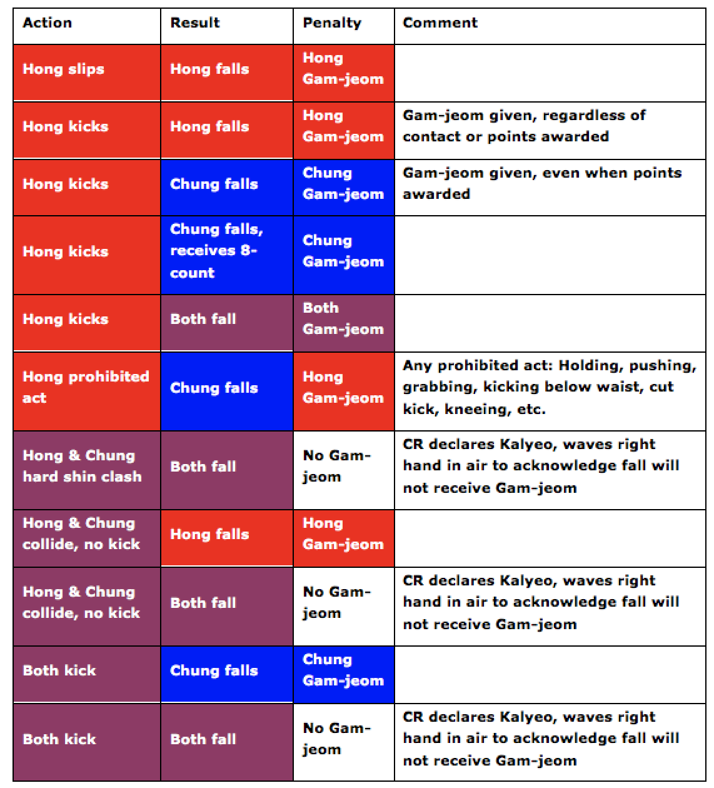
2. Falling down

Slide 53
3. Grabbing
Grabbing any part of the opponent’s body, uniform or protective equipment with the hands to gain an advantage
Grabbing the foot or leg, or hooking either one on top of the forearm
Hooking/wrapping with the leg
If one player is holding and opponent is pushing to get away from being held, Gam-jeom is given to the player who is holding
If hand(s), arm(s) extend beyond and “wrap” or squeeze the body of the opponent, it is considered grabbing, and Gam-jeom is given
Notes:
Talking Points:
• Demonstrate holding—some people wrongly think that because the language of the rules has changed, holding is ok.
• WT wants to eliminate clinching, but they also want to eliminate needless Kal-yeos, If players clinch, let them go for up to 3-5 seconds before breaking; if a player is holding, call the Gam-jeom.

Slide 54
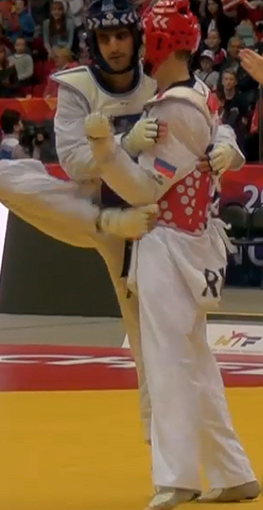
4. “Zoo Kicks”
“Monkey kicks” are illegal
“Scorpion kick” to the head is not a turning kick — only 3 points
“Fish kick” to the body is not a turning kick — only 2 points
Give Gam-jeom for grabbing for a “zoo kick” and invalidate any points scored if you see:
Any holding / grabbing
Any body contact
Otherwise, the points are valid
“Monkey kick”

Slide 55
5. Pushing
For pushing, the following acts shall be penalized:
Pushing the opponent out of the Boundary Line
Pushing the opponent in a way that prevents kicking motion or any normal execution of attacking movement
Pushing the opponent after he/she begins attacking motion
Pushing with holding or grabbing
Grappling, throwing, tripping or turning the opponent around
No penalty to pusher if opponent falls down, except in above cases; fallen player receives Gam-jeom

Slide 56
6. Avoiding or delaying the match
Stalling or running away with no intention of attacking
Retreating from technical engagement only to avoid the opponent’s attack or to run out the clock
“5-Second Rule”
Players have about five seconds to set up
If no action, give “Fight” command and hand signal
If there is no activity within five seconds after the command, give Gam-jeom to the contestant who moved backwards or was more inactive
You can give Gam-jeom to both players if they were equally inactive
If there are fewer than five seconds remaining in the round, you may give Gam-jeom immediately if a player is not fighting
Notes:
Talking Points:
• Discuss the 10-second rule in some detail.

Slide 57
6. Avoiding or delaying the match
If a player asks to fix arm or leg pads, the referee may choose to stop, or may indicate “fight”
If the player stops anyway, give Gam-jeom
For safety and scoring reasons, referee must allow players to fix gloves, socks or PSS
Includes turning the back, or evading the opponent’s attack by bending below waist level or crouching
To keep the match moving, referees should be diligent in enforcing “avoiding” penalties
Notes:
Talking Points:
• Discuss the safety issue of evading actions that cause the player to lose eye contact with the opponent.
• Player cannot call time and stop to fix equipment. If a player just stops and bends over to fix equipment without the referee calling time, Gam-jeom penalty can be given.

Slide 58
6. Pretending Injury
Exaggerating injury or indicating pain in a body part not subjected to a blow for the purpose of demonstrating the opponent’s action as a violation
Exaggerating pain for the purpose of elapsing the match time
If video replay is in use, the referee may request IVR clarification before giving a Gam-jeom for pretending injury

Slide 59
7. Lifting the leg...
When a contestant lifts a leg or executes kicking motions without touching the foot to the mat for more than 3 seconds — give Gam-jeom if:
Kicking leg remains in the air for more than 3 seconds
Player lifts leg above the knee and then returns it to the floor without kicking
Lifting the knee twice between the mid-point of the knee and ankle
Player hops forward twice without kicking or extending leg; a single hop is okay, as long as it’s followed by a kick
Lifting the knee to block is a Gam-jeom penalty
Leg is usually vertical if the contestant intends to block
Lifting the knee in order to kick is not penalized

Slide 60
8. Kicking below the waist
“Below the waist’ is defined as below the trunk PSS
Gam-jeom for:
Any kick that makes contact with opponent’s body below waist level
No Gam-jeom for:
Low push/cut kick that does not contact opponent’s lower body, if followed by kicking or punching techniques in combination motion
Unintentional or careless attack on any part below the waist — including “butt shots”
Strong kicking or stamping actions to any part of the thigh, knee or shin for the purpose of interfering with the opponent’s technique
Example: “cut kick” to the leg or lower body

Slide 61
8. Kicking below the waist
If caused by the recipient in the course of an exchange of techniques, no penalty is given
A player can’t intentionally jump up, or jump forward and up, to avoid a kick by causing opposing player to kick low
First time, no penalty; second time, Gam-jeom (Avoiding the Match)
Do not penalize casual collision of kicking legs during exchange of techniques
Can only call Kye-shi for kicking below the waist for
Groin kick
Twisted ankle
Broken bone
Dislocated joint

Slide 62
9. Attacking after “Kal-yeo”
Attacking after Kal-yeo normally requires that the attack results in actual contact to the opponent’s body
Even if an attack after Kal-yeo did not land on the opponent’s body but appeared deliberate and malicious, the referee may penalize the behavior with a Gam-jeom
The timing of Kal-yeo shall be defined as the moment that the referee’s hand signal was completed (with fully extended arm); the start of the attack is defined as the moment the attacking foot is fully off the floor
If the attacking motion started before the Kal-yeo, no penalty
If leg is lifted when the referee calls Kal-yeo, and the player then extends and kicks his opponent, it is considered as “Attack after Kal-yeo”

Slide 63
10. Attacking the fallen opponent
A player is defined as fallen when any part of the player’s body, other than the soles of the feet, touches the floor.
A falling player is still subject to legitimate attack, and may be at risk — so the referee must be alert to step in with “Kal-yeo”
Gam-jeom should be given for intentionally attacking the fallen opponent regardless of the degree of impact
Gam-jeom may also be given if a contestant maliciously pretends to attack the fallen opponent
Notes:
Talking Points:
• Discuss the situation of the falling player, and emphasize that the referee must be in position to step in with “Kal-yeo” and protect the player.

Slide 64
11. Hitting opponent’s face with hand
Hitting the opponent’s face or head with the hand (fist), wrist, arm, or elbow
Unavoidable actions due to the opponent’s carelessness — such as excessively lowering the head or carelessly turning the body — are not penalized
It is good practice to always give a Gam-jeom for a hand to the head; if you let it go, it might escalate

Slide 65
12. Butting or attacking with knee
Head butting or attacking with the knee when in close proximity to the opponent
Lifting the knee to block and / or impede the opponent’s kicking attack
No penalty for inadvertent contact as the result of technical exchange
When opponent rushes in abruptly at the moment a kick is being executed
As the result of a discrepancy in distance in attacking

Slide 66
13. Misconduct of player or coach
Not complying with a referee’s command or ruling
Inappropriate protesting or criticizing of officials’ decisions
Provoking or insulting officials, opposing contestant, coach or spectators
Loud coaching during the rounds (Can’t disrupt flow of match)
Coach standing or leaving the 1m x 1m Coach’s Zone
Unaccredited doctor/physicians or other team officials found to be seated in the doctor’s position
Any other undesirable behavior or unsportsmanlike conduct; behavior that is not within “normally acceptable limits”
Coach requests a PSS test during third round or Golden round, and nothing is found wrong with the system

Slide 67
No Points After An Illegal Act
Points cannot score after an illegal act even if the act was not instrumental to the points
Example: Kicking below the waist with double action
First kick is low (with contact), and second is high and scores
Referee gives Gam-jeom for low kick and removes the points
Example: Contestant steps out of bounds, comes back in and scores
Referee gives Gam-jeom for crossing Boundary Line, and removes the points
Example: Points scored with a kick that started after Kalyeo
Referee gives Gam-jeom for attacking after Kalyeo, and removes the points

Slide 68
Two Gam-jeoms to the same player
In general, only one Gam-jeom can be given to a contestant, even if the contestant has committed multiple infractions
Example: If a player steps outside the boundary line and kicks the opponent below the waist, referee may only give one Gam-jeom (either Crossing the Boundary Line or Kicking below the waist)
Exception: if the second infraction is either
Attacking after Kalyeo, or
Misconduct

Slide 69
Two Gam-jeoms to the same player
Example: A contestant kicks below the waist, and as the referee calls Kalyeo, the same player kicks after Kalyeo
First gives Gam-jeom for kicking below the waist, and then gives a second Gamjeom for kicking after Kalyeo
Example: A contestant punches the opponent in the face, and then says something inappropriate
First gives Gam-jeom for punching to the face, then gives a second Gam-jeom for Misconduct
Example: A contestant falls down and pretends injury while on the ground.
First gives Gam-jeom for falling down, and then gives a second Gam-jeom for Misconduct

Slide 70
Administering Penalties
Referee shows hand signals for:
Falling (shown before Gam-jeom)
Crossing the Boundary Line
Grabbing
Pushing
Avoiding the match
Attacking with the knee / blocking with the knee and leg
Attacking below the waist
Attacking after Kal-yeo
Attacking the fallen opponent
Lifting leg for more than 3 seconds / lifting without follow up
Hitting the opponent’s head with the hand
Misconduct / Head Butting / JSR

Slide 71

Click icon to start movie, or go to this link: https://drive.google.com/file/d/1z37PHZA8xzTuV4m7JqonIwLKNVt7pv6c/view?usp=sharing

Slide 72
Serious Misconduct
If a contestant/coach intentionally and repeatedly refuses to comply with the Competition Rules or the referee’s orders, the referee may also declare a sanction request by declaring Gam-jeom, and raising a Yellow Card
Report to Referee Chair immediately with an official written report
Competition Supervisory Board will investigate and determine if sanction is appropriate
If action happens after match has ended, simply show Yellow Card; do not call Gam-jeom
A Yellow Card is a very serious matter, and should be used only as a last resort

Slide 73
Manipulating the scoring system
If there is intentional manipulation, or attempt to manipulate the PSS, the referee will declare the violating competitor the loser by disqualification for unsportsmanlike behavior (DQB)
In this case, a Yellow Card is also appropriate
Notes:
Talking Points:
• The checking should be done quickly and unobtrusively. Dig deeper if you think there might be a violation.

Slide 74
Yellow Card Procedure
Only the Center Referee may give a Yellow Card
Other referees may advise the Center Referee to give a Yellow Card
First, Gam-jeom for misconduct should always be given before the Yellow Card is shown
If the bad behavior continues, the referee gives a second Gam-jeom, and raises a Yellow Card
After raising the first Yellow Card
If the player/coach realizes his mistake and calms down, the referee can call “Kye-sok” and continue with the match
If the bad behavior continues, the referee gives a third Gam-jeom, raises a second Yellow Card, and ends the match immediately
For extreme misconduct, referee may raise the Yellow Card after giving the first Gam-jeom

Slide 75
Yellow Card Procedure: Post Match
The Center Referee fills out the Yellow Card Report
Any other referee who advised on the Yellow Card must also contribute to the report
The Yellow Card Report is given to the Referee Chair for review
The Tournament Committee convenes a Competition Supervisory Board (CSB)
5 members: Referee, Coach, Athlete, Tournament Committee, Technical Delegate/Official
The Referee and other involved parties are called by the CSB to give a report and answer questions
The CSB makes a recommendation on sanctions
USATKD makes a final decision on sanctions based on the CSB report.

Slide 77
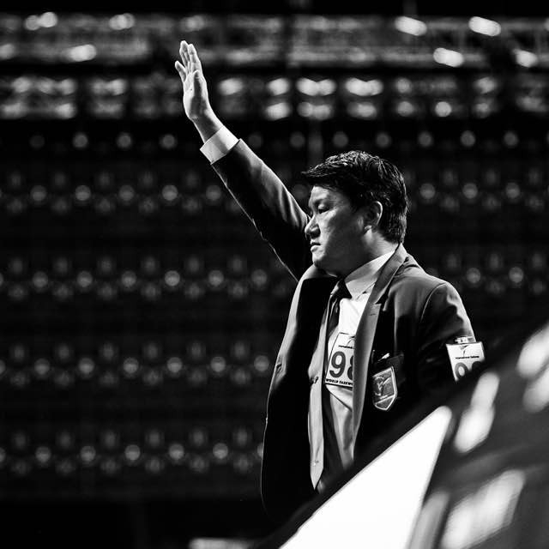
Section 5: Referee Duties & Responsibilities

Slide 78
Referee Responsibilities
Has control over the match, and protects the safety of the competitors
Declares “Shi-jak,” “Keu-man,” “Kal-yeo,” “Kye-sok” and “Kye-shi,” winner and loser, deduction of points, warnings and retiring
If an Inspection Desk is not in use, the referee inspects the contestants’ safety equipment, dobok, metallic articles, etc. — Chung first, and then Hong
Sometimes, inspection is done at ring-side by other officials; in this case, the referee needn’t inspect again

Slide 79
More Referee Responsibilities
Has the right to make decisions independently in accordance with the rules
The referee does not award points
In the case of a scoreless Golden Round in which the other criteria are inconclusive, the decision of Superiority is made by the corner judges and the referee
In case of a tie, referee decides

Slide 80
Decisions: Ways to Win
Referee Stops Contest (RSC)
After a legitimate technique, the opponent cannot demonstrate the will to resume the contest by the count of “Yeo-dul”
When the referee or doctor determines that a player cannot continue, even after a one minute recovery period
When a contestant disregards the referee’s command to continue
In case of a severe mismatch, where the referee feels a player may be in danger if the match continues
Win by final score (PTF)
Winning player scores more points than the opponent

Slide 81
Decisions: Ways to Win (continued)
Win by Point Gap (PTG)
When there is a 20-point difference at the completion of the second round, or at any time during the third round
If only two rounds, point gap occurs upon completion of the first round or any time during second round
Win by Point Gap may be waived in semi-finals and finals by decision of the Tournament Committee
Win by Golden Points (GDP)
When a player wins the Golden Point round

Slide 82
Decisions: Ways to Win (continued)
Win by Superiority (SUP)
Winner decided according to Rules of Superiority
Win by withdrawal (WDR)
Player withdraws from the match due to injury or other reasons
Player does not resume the match after the rest period or fails to respond to the call to begin the match
Coach throws in the towel
Win by disqualification (DSQ)
Player fails to make weight or loses contestant status before the competition begins

Slide 83
Decisions: Ways to Win (continued)
Win by referee’s punitive declaration (PUN)
When a player accumulates a total of ten Gam-jeoms
Win by disqualification for unsportsmanlike behavior (DQB)
If it is determined that a contestant or his/her team member has tried to manipulate the sensor(s) or scoring system of the PSS
If a contestant or coach refuses to follow the referee’s commands or to comply with the Competition Rules, or commits other serious misconduct
If a contestant attempts to cheat weigh-in procedures
If a contestant violates anti-doping rules

Slide 84
Decisions: Ways to Win (continued)
Invalid Result Mark (IRM)
Double Disqualification
Double Withdrawal
Double Disqualification for unsportsmanlike behavior

Slide 85
Golden Round
In the event the winner cannot be decided after 3 rounds, a 4th “Golden Round” will be conducted
The duration of this round shall be one (1) minute
The first contestant to score two points, or whose opponent receives two “Gam-jeoms” in the Golden Round will be declared the winner

Slide 86
Golden Round
In the event that neither contestant has scored two points in the Golden Point round, the winner shall be decided by superiority based the following criteria:
Contestant who scored one punch in the Golden Round wins; if tied:
If both or neither scored a single punch, the contestant who achieved a higher number of hits registered by PSS during the Golden Round
In a Golden Round, if a PSS hit occurs as a result of a penalized action, the referee must wave off the PSS hit (similar signal to waving off points, but with closed fist)
If number of hits registered by the PSS is tied, the contestant who won more rounds in the first three rounds
If the number of rounds won is tied, the contestant who received fewer Gam-jeom penalties during all four rounds

Slide 87
Superiority
If all of the above criteria inconclusive, the referee and judges decide the match based on who showed greater initiative
Based on Golden Round only — not the whole match!
Initiative is judged by these criteria, in this order:
Technical dominance of an opponent through aggressive match management
A greater number of techniques executed
The use of more advanced techniques, both in difficulty and complexity
Display of a better competition manner
If the superiority decision is tied among the referee and judges, the decision of the referee is the determining factor

Slide 88
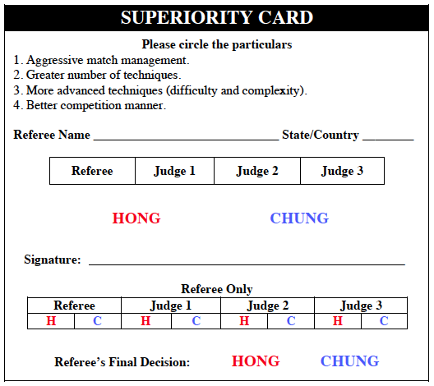
Superiority Card
Be sure to have a Superiority Card and pen with you before the match begins

Slide 89
Procedure for Superiority
At the end of the overtime round, the referee takes two steps back, and says “Woo-se ki-rok”
The corner judges complete their cards, and present them to the referee
The referee completes his/her own card, records the result, confirms the result with the T.A., and declares the winner
With three corner judges, if there is a 2-2 tie, whichever player the the referee voted for is the winner
The referee turns the cards over to the T.A.
Notes:
Talking Points:
• Two steps back, starting with left foot.
• Judges walk to center of the ring, referee doesn’t go to judges.

Slide 90
Knock-Down
Definition: When a contestant is knocked to the floor or is staggered or unable to respond adequately to the requirements of the match due to a legal technique
When any part of the body other than the sole of the foot touches the floor due to the force of the opponent’s permitted technique
When a contestant is staggered and shows no intention or ability to continue
When the referee judges that, in the interest of safety, the contest cannot continue as the result of a contestant being struck by a permitted technique
Any situation where — as the result of legal contact — it would be dangerous to continue or when there is any question about the safety of a contestant

Slide 91
Knock-Down Procedure
Declare “Kal-yeo” (break); the Recorder stops the match clock
Keep the attacker away from the downed player
Check the player’s condition, call doctor if necessary
Count at one-second intervals
“Ha-nah, Duhl, Seht, Neht, Da-seot, Yeo-seot, Il-gop, Yeo-dul, A-hop, Yeol”
You can call for the doctor while you’re counting
Continue to count, even if match time has expired
You MUST count to eight — even if the player is ready to continue before then

Slide 92
Knock-Down Procedure
Player demonstrates will to continue by standing in fighting position, fists up
Must be alert and ready to go
Don’t spend additional time confirming the competitor’s recovery after counting to “Yeo-dul” — check them while you’re counting
Resume the contest by declaring “Kye-sok” (continue)

Slide 93
Knock-Down Procedure
If a player clearly recovers before the count of “Yeo-dul” and expresses the will to resume, but still needs medical treatment...
Resume the match by declaring “Kye-shi” (injury time-out) and proceed accordingly
If a downed player cannot demonstrate the will to resume the contest by the count of “Yeo-dul” (eight), continue counting: “A-hop,” “Yeol”
Once you count past eight, the game is over; you must finish the count and declare a “Referee Stops Contest”

Slide 94
Knock-Down, 8-Count, But No Score
Body shot (PSS and non-PSS):
Referee counts to “Yeo-dul” (eight); if player is able to continue by the count of eight, referee declares “Kye-sok” and continues the match
Referee may request IVR to determine if pretending injury
Head shot (PSS):
If player is able to continue by the count of eight (“Yeo-dul”), referee requests Video Replay — using his/her own card — to determine if points should be awarded
Head shot (non-PSS)
Judges should indicate by raising 3 (or 5) fingers that points should be scored ... or not
If judges do not confirm the points, referee will request Video Replay

Slide 95
Knock-Down, 10-Count, But No Score
Body shot (PSS and non-PSS) or Head Shot (PSS):
Referee counts to “Yeol” (ten): declare “Kye-Shi” then request a Video Review to determine if the count was from a legal technique.
If the technique is legal, declare the winner by RSC.
If the technique is not legal, continue the “Kye-Shi” procedure and award a Gam-Jeom as necessary
Head shot (non-PSS)
Judges should indicate by raising 3 (or 5) fingers that points should be scored ... or not
If judges do not confirm the points, referee will request Video Review

Slide 96
Both Players Knocked Down
If both players are knocked down, continue counting as long as one of the contestants has not sufficiently recovered
If neither player recovers by the count of “Yeo-dul,” winner is decided based on the match score before the knock-down

Slide 97
Medical Suspension
Any contestant who is unable to continue the match as a result of a serious injury, regardless of the part of the body, will not be allowed to compete for the next 30 days
Medical suspension period for concussion
Under 14: 50 days
15 – 17: 40 days
18 and over: 30 days

Slide 98
“Kye-shi”: Injury Time-Out
If a contestant receives an injury, the referee stops the match by declaring “Kal-yeo,” and announces “Kye-shi” (60-second suspension)
Bleeding and/or injury to the eye(s)
Dislocation of joint or broken bones
Twisted ankle
Kick to the throat or groin, strong punch to the face
The referee may call for the doctor, and the player is allowed one minute to receive first aid; the one-minute “Kye-shi” injury time period starts when the medic steps onto the mat

Slide 99
“Kye-shi”: Injury Time-Out
If the referee determines that a fallen player is not actually injured, but only in pain, the referee declares “Kal-yeo” and gives a command to resume the match by saying, “stand-up”
If the contestant refuses to continue the match after the referee gives the command “stand up” three times (3 seconds between each call), the referee declares the match over (“Referee Stops Contest”)
Referee may call doctor before the third stand-up call, if the referee suspects the contestant may be injured

Slide 100
“Kye-shi”: Injury Time-Out
While the player is receiving medical treatment or is in the process of recovering, 40 seconds after the declaration of “Kye-shi,” the referee begins to loudly announce the passage of time in five second intervals — saying, “40 seconds,” “45 seconds,” etc.
If the player clearly indicates the intention to proceed, but treatment is required and the doctor is unavailable, or if additional treatment is necessary, the referee can extend the one-minute time limit, but should not extend it for more than one extra minute
Time limit is extended by calling “Shi-gan”, and immediately followed by a second “Kye-shi”
Resume the match by declaring “Kye-sok” (continue)

Slide 101
“Kye-shi”: Injury Time-Out
It is the decision of the referee, after consulting with the doctor, whether or not it is possible for the contestant to resume the match
If the player is unable to resume the match after one minute...
If the injury was caused by a legal action, accidental contact, (or no contact) — the injured player loses
If the injury was caused by an illegal action penalized by Gam-jeom — the player causing the injury loses
The referee must call tournament medical staff for the second one-minute injury time-out for the same injury, and ask whether the injured contestant is able to continue

Slide 102
Uncontrollable Circumstances
If uncontrollable circumstances force you to end a match prematurely...
If the match is suspended after the end of the second round, results are determined according to the match score at the time of suspension
If the match is suspended before the end of the second round, a full three-round rematch should be conducted
In this type of situation, follow the directions of the Referee Chair and Tournament Committee

Slide 103
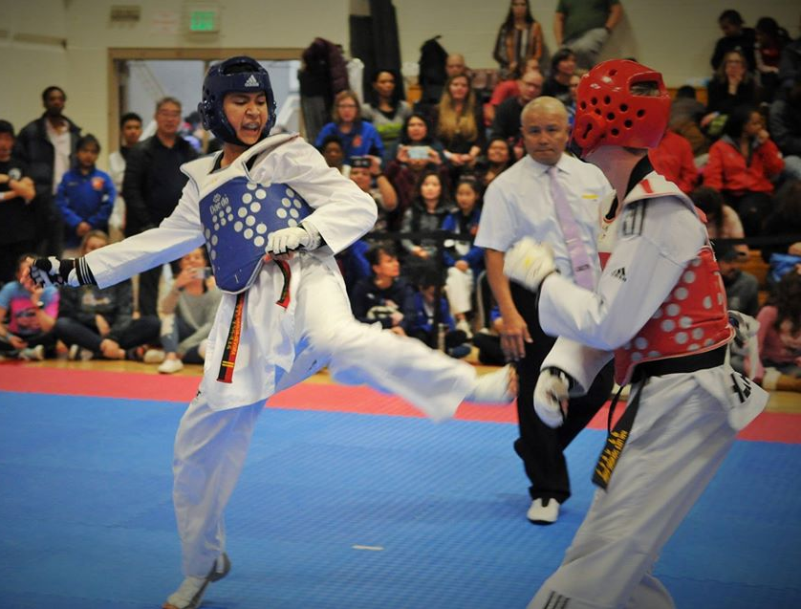
Section 6: Junior Safety Rules

Slide 104
Purpose of Junior Safety Rules
Intended to standardize safety guidelines for all non-adult Taekwondo competition in the United States
Ensure that young persons participating in competitive Taekwondo sparring are protected, insofar as possible, from concussive head injuries
Allow developing young Taekwondo athletes to compete with the reasonable assurance that they will not be subjected to forceful head contact
Two classes, depending on belt level and age group:
No head contact: Contact to the head is not permitted
Light head contact: Only light contact to the head is permitted

Slide 105
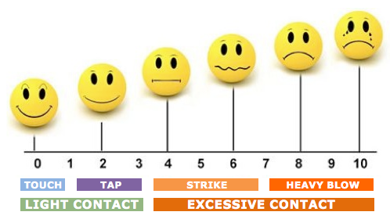
“Light Contact” — A Touch to a Tap

Slide 106
No Head Contact Procedure
Ages 7 & Under (All Belts) Ages 11 & Under (Color Belts)
Any kick that touches the head area will result in a “Gam‑jeom” penalty to the kicker
In the event of any kick to the head, the referee will immediately call the tournament medical staff to inspect the injured contestant, and declare “Kye-shi”
If, in the opinion of tournament medical staff, a competitor cannot continue because of a kick to the head, the attacker will be disqualified
The decision whether a competitor is able to continue is made solely by the referee in consultation with the tournament medical staff

Slide 107
No Head Contact Procedure
Ages 7 & Under (All Belts) Ages 11 & Under (Color Belts)
Inability to continue because of fright, crying or loss of will following a kick to the head does not constitute grounds for disqualification of the attacker
If a technique is directed at the head and does not make contact, the referee may give a verbal warning. Multiple instances of the same action may result in “Gam-jeom” penalty — or even disqualification — if the player continues to ignore the referee’s directives
Before and during the match, referees should remind players and coaches that No Head Contact rules are in effect

Slide 108
Light Head Contact
Ages 8 – 11 Black Belts Ages 12 – 14 Cadet Division Grass Roots Black Belts and Color Belts Ages 15 – 17 Color Belts
Ultras (33+) Color Belts and Black Belts
Competitors are allowed to kick to the head using light contact only
A competitor who executes a successful, light contact kick to the head shall be awarded three (3) points
No extra points for turning kick to head under Junior Safety rules
Turning Kicks: Four points for successful turning kicks to the body

Slide 109
Light Head Contact Procedure
If a competitor executes a kick to the head that is deemed by the referee to be more than light contact, he/she will be given a “Gam-jeom” penalty
The referee will immediately call “Kal-yeo,” summon the tournament medical staff to inspect the contestant, and then “Kye-shi”
The referee will declare a “Gam-jeom” penalty, using hand signal for “misconduct” (finger to lips), and then invalidate any points that have been awarded for the technique
If, in the opinion of the tournament medical staff, the competitor cannot continue because of excessive contact to the head, the attacker will be disqualified
The decision whether a competitor is able to continue is made solely by the referee in consultation with the tournament medical staff
If an athlete is determined as not able to continue by medical during the match, they may not compete for the remainder of the event.

Slide 110
Light Head Contact Procedure
Don’t be shy about calling Gam-jeom for excessive contact! Better to give penalty early than to risk injury and disqualification later
Inability to continue because of fright, crying or loss of will following a kick to the head does not constitute grounds for disqualification of the attacker
If the referee sees that a player is directing excessively forceful techniques to the head area, even if the foot does not make contact, the referee may give a verbal warning
Multiple instances of the same action may result in “Gam-jeom” penalty — or even disqualification — if the player continues to ignore the referee’s directives
Before and during the match, referees should remind players and coaches that Light Head Contact rules are in effect

Slide 111
Light Head Contact Explanation
The degree of allowable contact does NOT increase according to the age, gender, size or rank of the competitors
The level of contact is determined solely by the observed force of the kick, not by the reaction, or non-reaction, of the recipient Indications of excessive contact include:
Abrupt snapping or displacement of the head as a result of the blow
Abrupt rotation of the head as a result of the blow
An audible “thump” or sound of the foot contacting headgear or face
Blood, injury — or apparent absence of injury — may not be valid criteria for determining whether a kick is light or excessive contact
Notes:
Talking Point:
• Injury can result with even minimal force when contact is made to the head area; for example, a light tap may be sufficient to cause a bloody nose, or grazing contact with a toenail might cause a minor cut. Conversely, a very serious blow to the head may show no visible injury, despite the possibility of a fracture, dislocation or concussion.

Slide 112
Light Head Contact Explanation
Under Junior Competition Rules, the referee DOES NOT give an 8-count for any kick, even a legal one, to the head area
If a kick to the head is powerful enough to warrant an 8-count, it is excessive
Note that the referee can and should begin an 8-count for any legal kick to the trunk area that results in a knock-down condition
This situation does not necessarily call for medical evaluation

Slide 113
Light Head Contact Enforcement
During a match, it is the center referee’s responsibility to correctly apply Light Head Contact rules
During the course of a tournament, the Ring Captain is responsible for the correct application of Light Head Contact rules by all of the center referees under his/her supervision
If the Ring Captain sees that a referee is allowing excessive head contact, he/she must take immediate action to correct the referee's actions and instruct the center referee to enforce the appropriate penalty
At the discretion of the Referee Chair, a referee who refuses to accept correction in this regard will not be allowed to referee Light Head Contact matches, and may be subject to disciplinary action or sanction

Slide 114
Adult Competition Rules
12 – 14 Cadet World Class Black Belts 15 – 17 Junior Division Black Belts 18 – up All Belts
Adult rules apply
At USATKD State Championships and Nationals, there will be two Cadet Divisions, Grass Roots (JSRs) and World Class (adult rules)
An athlete cannot compete in both divisions

Slide 115
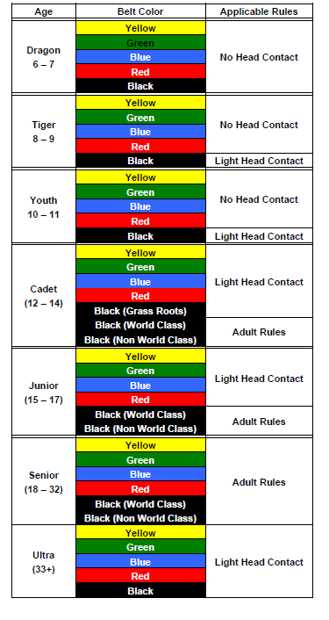
Nationals and State Qualifiers

Slide 116
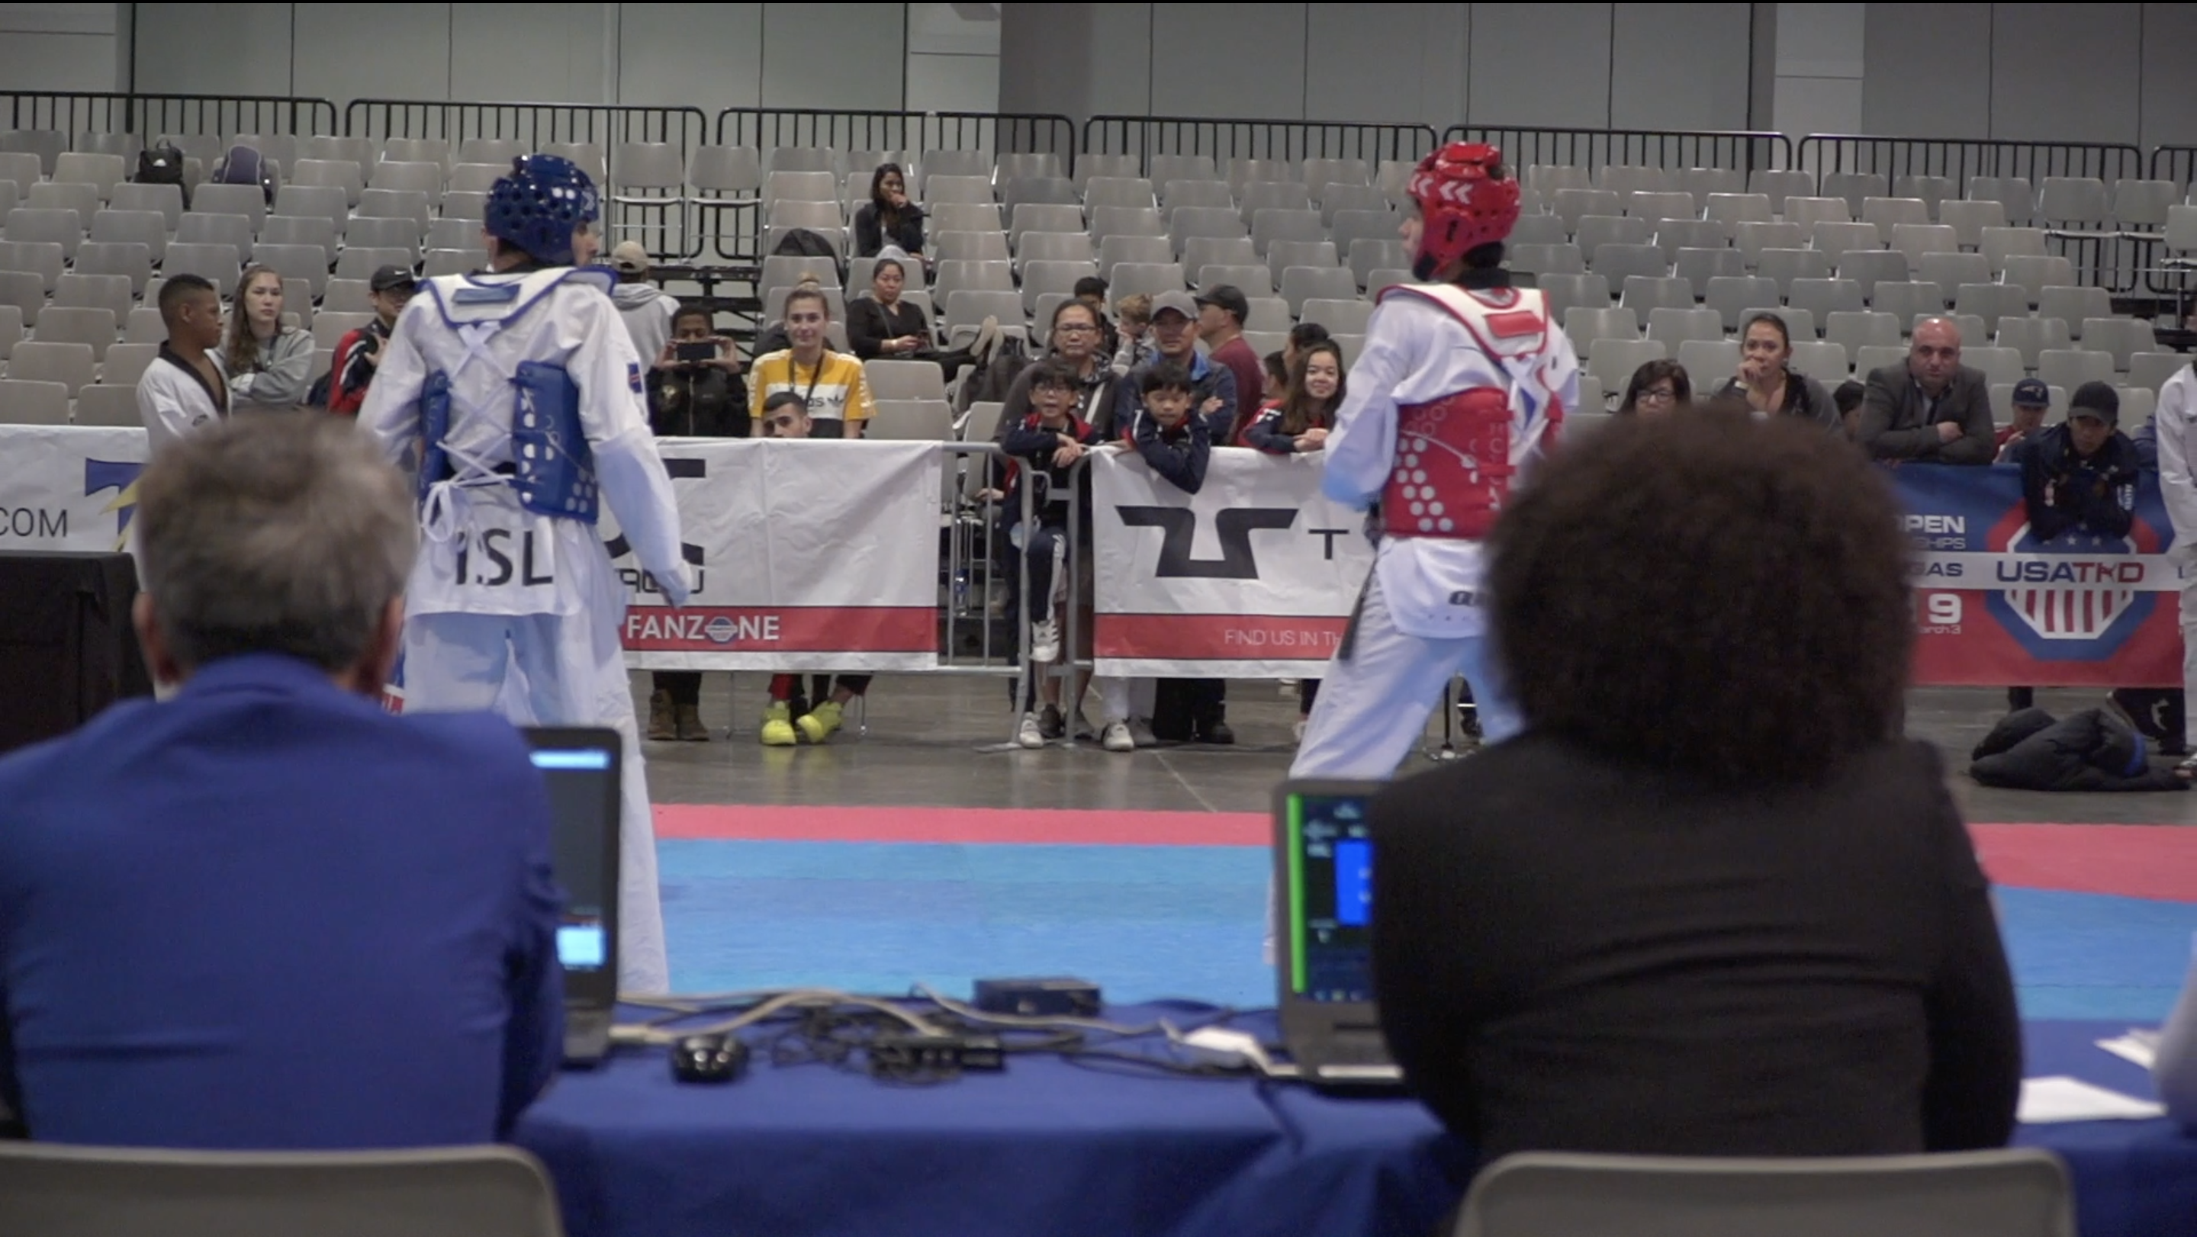
Section 7: Ring Captain (R.C.) and Technical Assistant (T.A.)

Slide 117
Ring Captain (R.C.) Duties
Senior-level referee who serves as team leader for the referee and judges in a ring
Answers to the Referee Chairman for the overall performance of the ring’s referee team
Mentors, coaches, guides and supports the referees serving in that ring
May also do referee and corner judge evaluations
Assigns referees and supervises ring assignments and rotation, using a Referee Assignment Sheet

Slide 118
Ring Captain (R.C.) Duties
Doesn’t micro-manage, but in critical situations makes sure that the referee team “gets it right”
Only steps in when necessary, but does step in if necessary
With the T.A., reviews Superiority Cards for accuracy and confirms the results before declaration
Anticipates — and handles — situations before they become problems

Slide 119
Technical Assistant (T.A.) Duties
Takes care of T.A. paper and match sheets
Works closely with the Computer Operator and ring volunteers
Makes sure start time, penalties, time-outs, etc. are correctly recorded
Checks to ensure that players are wearing correct size Hogu, and that PSS hit levels are correct for the division

Slide 120
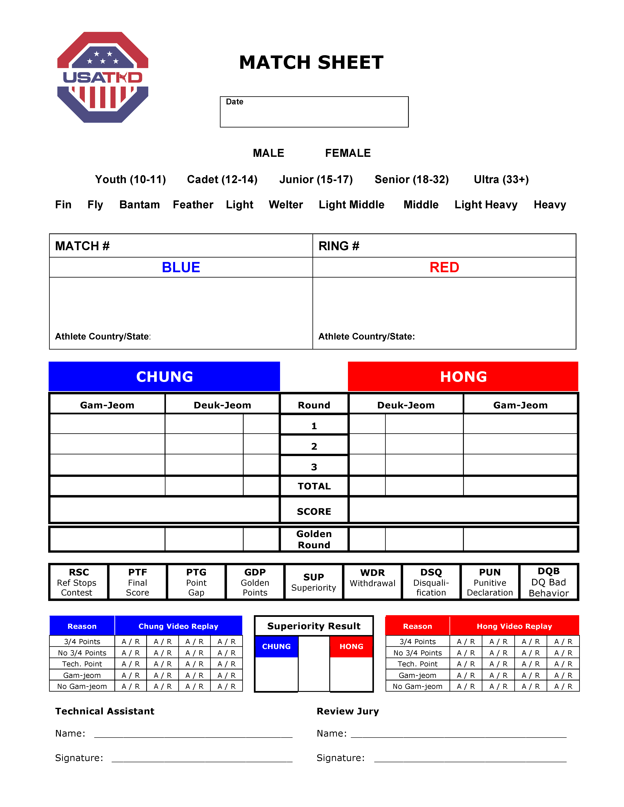
Match Sheet

Slide 121
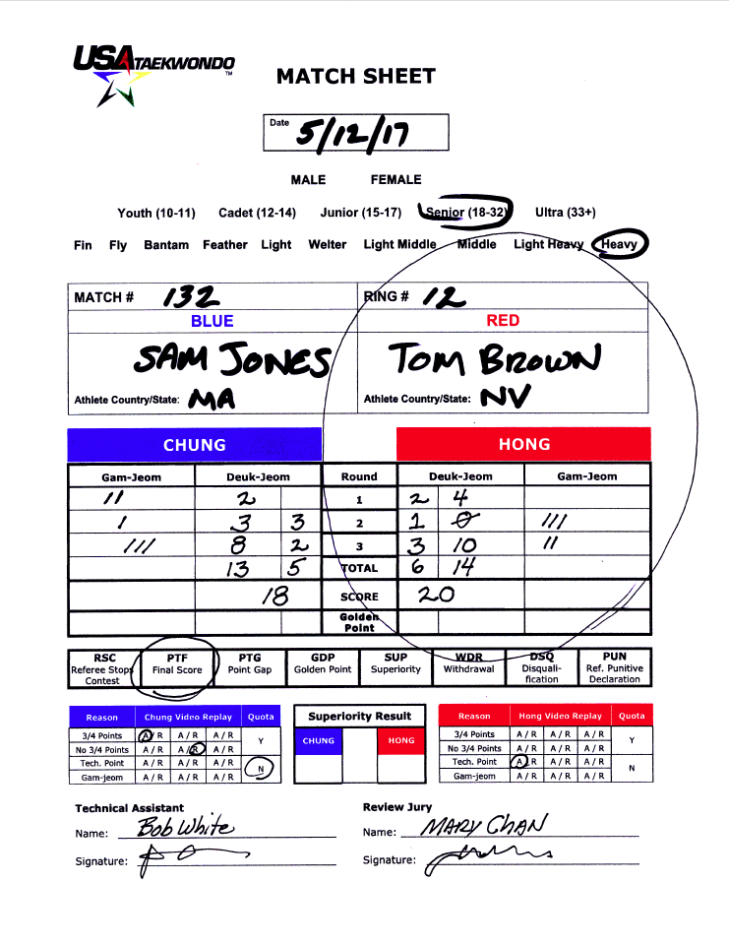
Completed Match Sheet

Slide 122
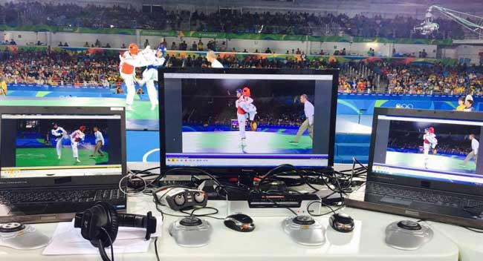
Section 8: Instant Video Replay

Slide 123
Instant Video Replay (IVR)
If there is an objection to a judgment of the refereeing officials during the contest, the coach of a team can make a request to the center referee for an immediate review of the video replay
Used for Nationals, Grand Slams and other USATKD competitions where possible and/or feasible
Each ring has one Review Jury consisting of a highly experienced USATKD Referee appointed by the Referee Chair
The T.A. or Ring Captain may also serve as the Review Jury
Review Jury should not be of the same state or training affiliation as either contestant

Slide 124
What Can Be Appealed
Penalties against the opponent for:
Falling down
Crossing the Boundary Line
Attacking the opponent after “Kal-yeo”
Attacking the fallen opponent
Technical point scored or not scored
Invalidation of any penalty against the coach’s own contestant
A wrong Gam-jeom hand signal may cause cancellation of a penalty
Example: Referee gives penalty for grabbing, but shows signal for attacking below the waist; coach requests removal of penalty for attacking below the waist

Slide 125
What Can Be Appealed
Points gained by the opponent while they were outside the boundary line, fallen, after kalyeo, or while attacking a fallen opponent
Coach request: “Points were gained following a prohibited act”
Must be related to one of the penalties against opponent that coach can ask for
If head PSS is not in use, coach may request instant video replay for a head kick scored or not scored
If the referee has awarded a Gam-jeom, but failed to remove any points scored following the illegal action

Slide 126
What Can Be Appealed — Technical Issues
Punch point awarded to the wrong player
Technical issue regarding punch point
Example: If two corner judges press, but one is outside the window
Ideally, corner judges will correct this on their own
Technical points applied to the wrong kick in a sequence
Example: Turning head kick that does not score (but judges press), immediately followed by 2-point kick to the body (not turning) that does score; the technical points pressed by the judges are scored against the body, incorrectly resulting in 4 points
Technical points given for a kick that is not a valid turning kick (e.g., fish kick, scorpion kick, stepping down turning kick, etc.)

Slide 127
What Can Be Appealed — Technical Issues
Any mechanical malfunction or error in time management
In this case, referee normally uses his/her own card
“Phantom points” or other apparent scoring malfunction
Referee may choose to use his/her own card if they also saw it
In Golden Round, if one player (apparently) scores a punch and the other player scores a PSS body kick, coach may request video review to see which player’s technique landed first
Same principle applies for head kick if manual scoring is in use

Slide 128
What Cannot Be Appealed
Kicks scored, or not scored, to the body
Kicks scored, or not scored, to the face or head if head PSS is in use
Punches scored or not scored (except for punch technical issues)
Reversal of a previous Video Replay decision
Invalidation of points gained through illegal action — unless it’s one of the penalties against opponent that coach can ask for

Slide 129
What Cannot Be Appealed
Two or more actions — with these exceptions:
Invalidation of points scored as a result of falling (i.e., spin kick where hand touches ground before kick scores)
Invalidation of points scored by opponent after he/she has crossed the Boundary Line
Two head kicks in same exchange (unless head PSS is in use)
If two Gam-jeoms are given to the contestant at the same time, with the second Gam-jeom being Attacking after Kalyeo or Misconduct (e.g., crossing the boundary line and attacking after Kalyeo), coach may ask for invalidation of both Gam-jeoms

Slide 130
Instant Video Replay Procedure
Coach gets one Video Replay card per match
In a single match, a coach may appeal as many times as he/she wishes, as long as each appeal is upheld by the Review Jury
If an appeal is denied, the coach loses the right to any further appeal in that match

Slide 131
Video Replay Procedure
Coach raises his/her Video Replay card
Referee declares “Kal-yeo,” returns the players to their marks, and approaches the coach
Coach gives the referee the card, and explains his/her request
Referee returns to the Referee’s Mark, holds the card up with the right hand and declares, “Chung, video replay,” or “Hong, video replay”
The referee approaches the Review Jury and briefly relays the coach’s request
After explanation, referee returns to Referee’s Mark to await decision

Slide 132
Video Replay Procedure
Appeal must be made within 5 seconds of the action or decision
Coach may request video replay within 5 seconds of VR decision or referee meeting — not necessarily within 5 seconds of the action itself
If a judge stands at same time as coach requests video replay.... coach should stay standing; if the judges fix it, they can sit down and keep their card
Referee must ask the coach the reason for every IVR request
Example: Coach requests IVR to remove Gam-jeom for going out of bounds, stating that his player was pushed out; if coach is correct, Review Jury instructs referee to remove Gam-jeom for crossing the boundary line, and give Gam-jeom for pushing to the other player

Slide 133
Video Replay Procedure
Review Jury reviews the video replay
Decision should be made within 30 seconds
If Review Jury requires a second opinion, he/she may consult the Referee Chairman
After review, the Review Jury informs the referee of the final decision
Accepted = Right thumb up
Rejected = Open hands crossed at wrist
The referee repeats the signal of the Review Jury
If the appeal is accepted, the referee returns the card to the coach; if rejected, the referee keeps the card and continues the match

Slide 134
Video Replay Procedure
The decision of the Review Jury is final
No further appeals on that issue will be accepted during or after the match
Exceptions: Errors in determining the match results, mistakes in calculating the match score or misidentifying a contestant.
In such instances, an official protest can be submitted according to the “Protest Procedure”

Slide 135
Video Replay Review Criteria
Review Jury must take into consideration any illegal action associated with a (non-PSS) head kick before giving “thumbs up” for an IVR challenge
If there is a grab, for example, before kicking to the head, the Review Jury must reject the request, but cannot instruct the referee to give a Gam-jeom to the offender
There must be clear video evidence to support overturning the field of play decision by the referee and/or judges
“Looks like maybe” or “probably” are not sufficient
If because of technical issues, the action was not captured on camera, Review Jury will reject the IVR challenge, but will instruct the referee to return card to the coach

Slide 136
Video Replay Special Situations
In the last 10 seconds of the final round or any time during the Golden Round, any of the corner judges may ask for IVR to add or remove technical points — but only if coach has no card
If there is a clear error in identifying a contestant or errors in the scoring system, any of the refereeing officials (including the TA) may request a review and correction of the decision at any time
If referee counts for head kick, but no points are scored, referee uses his/her own card to verify points
To verify injury vs. pretended injury before giving a Gam-jeom
Notes:
Notes:
• Obviously, the goal is to GET IT RIGHT.
• Note that in event of clear error in identifying or in scoring system, TA now has ability to request review and correction. (In USATKD, we’ve always done it this way; now WT is doing it, too.)
• Once refereeing officials leave the contest area, no further review or correction is possible.

Slide 137
Video Replay Special Situations – PSS test
Coach may request a PSS test with the IVR card
During the 1st and 2nd round, referee uses his/her own card
During the 3rd round and golden round, referee uses the coach’s card.
If something is wrong with the system, referee returns the card to the coach
If nothing is wrong with the system, referee keeps the coach’s card and give a Gam-jeom to the coach (misconduct)
Referee may also request a PSS test to be sure that PSS is working correctly
Notes:
Notes:
• Obviously, the goal is to GET IT RIGHT.
• Note that in event of clear error in identifying or in scoring system, TA now has ability to request review and correction. (In USATKD, we’ve always done it this way; now WT is doing it, too.)
• Once refereeing officials leave the contest area, no further review or correction is possible.

Slide 138
When Can IVR Instruct Ref To Give Penalty?
Review Jury can instruct the referee to give a penalty only if it is related to something the coach may ask for — falling, out of bounds, attacking after kalyeo, attacking a fallen opponent
“The opponent stepped out of bounds”
If accepted, Gam-jeom is given to opponent
“No Gam-jeom for my player for falling, because she was grabbed”
If accepted, remove Gam-jeom for falling and give Gam-jeom for grabbing to the opponent
The coach can ask for grabbing here, because it is related to the falling for which their player was penalized

Slide 139
A Few More Examples...
“No Gam-jeom for my player for grabbing”
IVR sees that the player was not grabbing, but the other player was
IVR accepts, and referee removes Gam-jeom from the coach’s player
Gam-jeom is not given to opponent, because grabbing is not one of the penalties the coach can ask for on opponent
“No Gam-jeom for kicking low, blue was blocking with the leg”
If accepted, referee will remove Gam-jeom for kicking low
Will not give Gam-jeom to opponent
“The opponent pushed my player while she was attacking”
Referee will pocket the card
Coach cannot ask for pushing penalty on opponent

Slide 140
A Few More Examples...
Multiple Head Kicks:
Coach requests 6 points for two head kicks; the Review Jury determines only one head kick is valid
Review Jury rejects the IVR, but instructs the referee to add 3 point to the player
Multiple Head Kicks:
Coach requests 3 points for a head kick; Review Jury determines that there are actually 6 points for two head kicks.
Review Jury accepts the IVR, but referee only adds 3 points to the player as requested

Slide 141
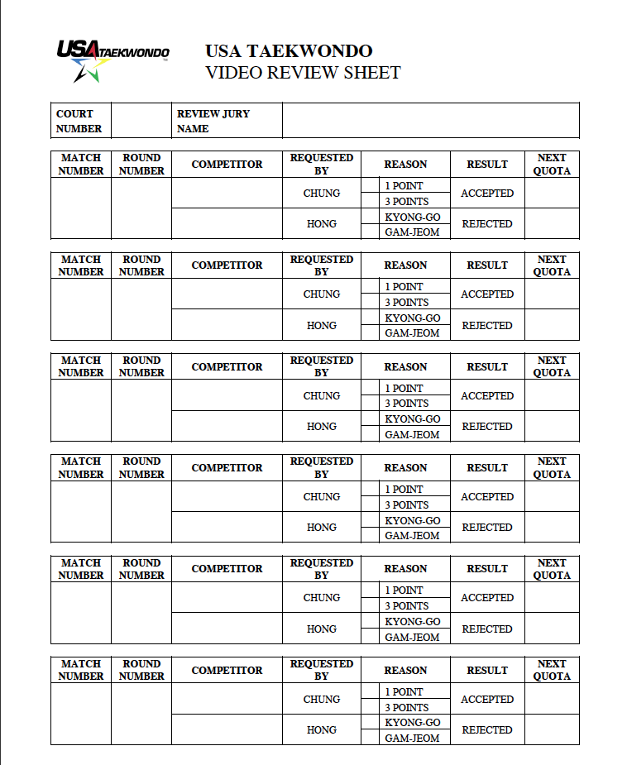
Video Replay Log

Slide 142
Competition Supervisory Board
The Competition Supervisory Board adjudicates protests and corrects misjudgments if necessary
May summon the refereeing officials for confirmation of events
Video tapes will not be admitted as evidence
If summoned, answer ONLY what’s asked, and stick strictly to the FACTS
Competition Supervisory Board may also take disciplinary action against the officials committing the infraction
May recommend that the Referee Chair replace referees or judges
Notes:
Talking Points:
Details, if anyone is interested:
• One Chair and fewer than six members, plus the Technical Delegate (usually, the Referee Chairman)
• Persons with sufficient Taekwondo experience—not just referees—appointed by the USATKD CEO or his/her designee.

Slide 143
Protest Procedure After the Match
Protest must be filed within 10 minutes after the match by a certified coach representing the athlete
Protest application is submitted to the Event Director, along with non-refundable fee of one hundred dollars ($100.00)
Official, field of play decisions made during and at the end of the contest are final and not negotiable
When Video Replay is in use, only errors in determining the match results, etc. may be protested

Slide 144
Protest Procedure After the Match
Treatment of the decision:
Errors in determining the match results, mistakes in calculating the match score or misidentifying a contestant shall result in the decision being reversed
If the referee made a clear error in applying the Competition Rules, the outcome of the error shall be corrected and the referee may be admonished or face sanction
When the Board decides that there was a clear error in judging the facts, such as the impact of striking, severity of action or conduct, intention, timing of an act in relation to a declaration or area, the decision shall not be changed and the official(s) seen to have made the error may be admonished or sanctioned

Slide 145
Coach Decorum
One coach may accompany the contestant to the competition ring when the contestant’s name is called to compete
The coach must meet all USATKD Coaching program requirements to be eligible to coach
The coach must observe the USATKD decorum code, the rules and regulations of the Organizing Committee, and the rules of the tournament
Violators of these rules and regulations may have their coaching privileges canceled by the USATKD and face additional sanction

Slide 146
Coach Decorum
During the competition, coaches are required to remain seated within the 1 x 1 meter coach’s box and NOT allowed to move about the ring during competition
The coach may not enter the ring during a competition
If his/her contestant is injured during a contest, the coach must wait for the referee to declare “Kal-yeo” and give permission before leaving the coach’s chair
The coach should wait for the doctor to arrive before touching his/her contestant
Coach should look and act professional at all times
Dress Code: No hats, slippers or flip-flops, jeans, shorts, leggings, or doboks; no cell phones or other communication devices in use

Slide 147
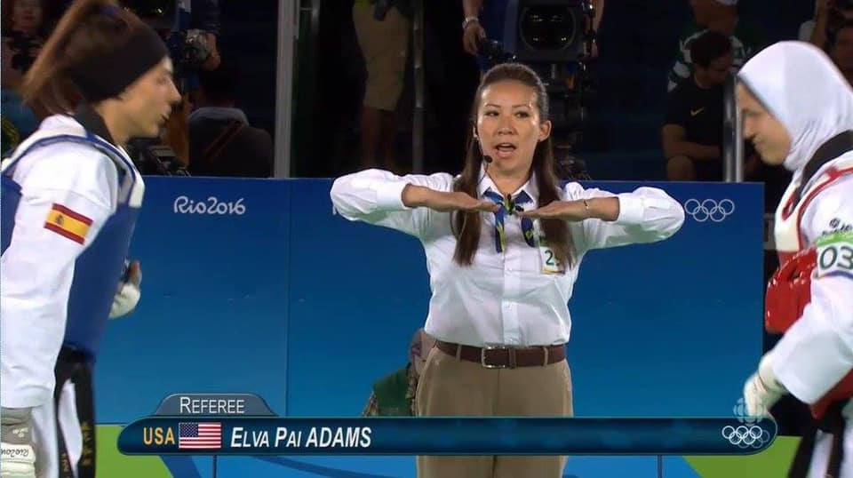
Section 9: Other Things You Should Know

Slide 148
Referee Code of Conduct
As a Referee, I will enforce the current Competition Rules in a fair and impartial manner, showing no favoritism to one competitor over another competitor.
Competitor safety is of the utmost concern as I perform my duties as Referee.
I will conduct myself as a professional in all of my actions during a competition event.
I will not accept favors of any kind in return for my actions as a Referee.
I will maintain proper physical conditioning in order to be able to perform my duties and responsibilities as a Referee.
I will accept critiques from supervisors in order to improve my abilities as a Referee.
I am an ambassador for Taekwondo and, as such, I must perform my duties in a firm and professional manner, using tact and diplomacy as needed.
I will not have any contact with competitors and coaches during the course of any tournament other than basic greetings and shall not dine or socialize with participating competitors and coaches during the course of any tournament.
I will recuse myself from any match in which my personal or professional relationship with a contestant or coach may give an appearance of conflict of interest or lack of impartiality.
Notes:
Talking Points:
• Be sure to carefully read the Referee Code of Conduct — and don’t sign it unless you are ready to abide by it 100%.

Slide 149
Matters Not Specifically Covered
Matters related to the competition will be decided through consensus by the refereeing officials of the pertinent contest
Ideally, these situations are decided according to:
Safety
Fairness
Common Sense

Slide 150
Words of Wisdom
No public comments about a particular match — ever!
“The walls have ears,” and “Loose lips sink ships.”
Only discuss match specifics in a closed room with the Referee Chairman, T.A. and/or other referees involved with that match
A casual comment like, “Dang, I should have scored that last head kick!” can — and usually will — come back to bite you
Don’t let anyone into your ring without your invitation
Includes coaches, tournament staff
Keep your ring area tidy — for safety, as well as for appearance
Notes:
Talking Points:
• A casual comment like, “Dang, I should have scored that last head kick!” can — and usually will — come back to bite you.

Slide 151
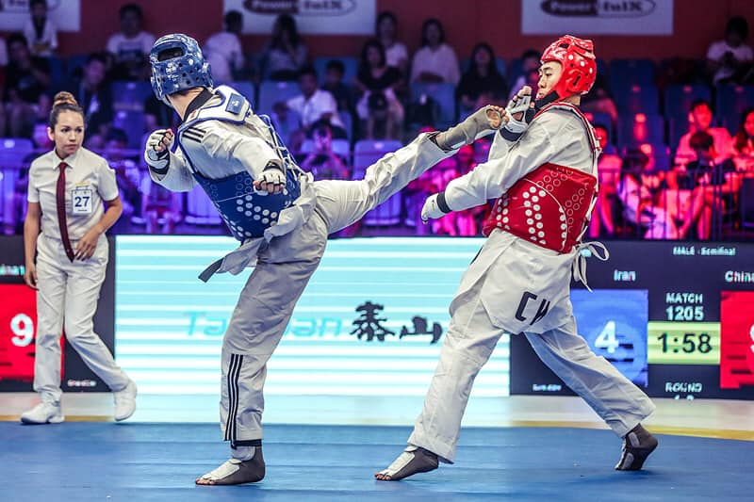
Section 10: What’s Next?

Slide 152
Get Experience as a Corner Judge
As a corner judge, you need to have a basic understanding of the Competition Rules, especially those that are referenced in this course
Get a copy of the complete USATKD Competition Rules
Read them through from time to time — especially before competitions
Observe the application of the rules in competitions you attend
Ask an experienced referee to explain anything that may be unclear to you

Slide 153
Become a Great Center Referee
If you want to venture into the center of the ring, you need to have a thorough understanding of the Competition Rules and match management procedures
Attend a USATKD-sanctioned referee seminar
Study the Competition Rules diligently
Referee at as many USATKD events as possible
Practice, practice, practice!
Repeat #1, 2, 3 and 4, above
Notes:
Talking Points:
• Practice your hand signals as you would practice poomsae; it helps to work with a coach/partner.

Slide 154
A Well-Marked Path to Success
USATKD
D, C, B and A levels
Earn promotion by attending seminars and referee camps, and participating in recognized events
As you advance, you’ll be invited to State Qualifiers, then and Nationals — and eventually, Grand Slams
World Taekwondo
Recommended USATKD A-level Referees can become International Referees
3rd Class, 2nd Class, 1st Class, Special Class

