Slide 1

FIGURE SPORT COMMITTEE UPDATE

Slide 2
WHO ARE WE
How do you find us, who do I talk to.
HOW DO I GET UPDATES?

Slide 3
International Youth Program
What it is. Why it will help. What it will look like.

Slide 4
What is the International Youth Program?
The International Youth Program is a reorganization and expansion of the set of International events in the USARS Youth structure.
In Solo and Team Dance, there will be International Dance events for each age division. Division names and requirements will be aligned with World Skate, which is the international standard for competition.
In Free Skating and Pairs, Short and Long Program events will be offered, with division names and requirements aligned with World Skate.
FIGURE DIVISIONS WILL REMAIN UNCHANGED.
DOMESTIC SOLO AND TEAM DANCE WILL REMAIN UNCHANGED
ADULT AND ELITE DIVISIONS WILL REMAIN UNCHANGED.

Slide 5
Why will this change be helpful?
The goal of the International Youth Program is to promote a high quality of skating in the younger divisions.
As in every sport, the standards of quality and difficulty in artistic roller skating have changed over the years. The International events are designed to reflect the modern standard of skating.
The expansion of International events is an enhancement to the existing USARS domestic structure. It gives coaches more options to develop their skaters in the way that suits them best.

Slide 6
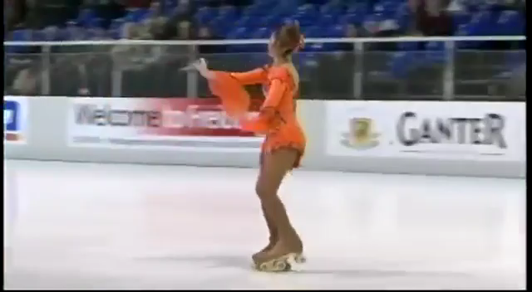
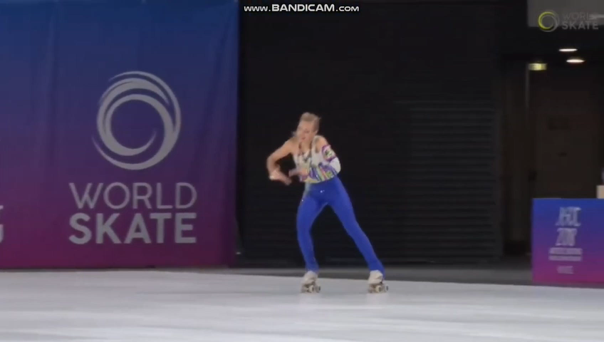
Example of Change in the Sport
Below is a video comparison of a Solo Dance step sequence at the World level in 2009 (left side) vs 2018 (right side).
This is not a commentary on the ability of the skaters. Both are World Champions. However, note the contrast in what was expected of a skater 10 years ago compared to now.

Slide 7
What will the International Youth Program look like?
The following slides summarize how the International Youth Program will fit within the existing USARS event structure.
ALL Figure divisions will remain UNCHANGED, so these are not pictured.
ALL Adult and Elite divisions will remain UNCHANGED, so these are not pictured.
ALL Creative and Show divisions will remain UNCHANGED, so these are not pictured.

Slide 8
Free Skating & Pairs
This enhancement will change most Free Skating and Pairs A events, adopting the World Skate structure and requirements.
Primary and Juvenile (now Tot and Mini) will skate a long program only, as they did before, but with World Skate requirements.
Advanced and B level Free Skating will remain unchanged for those who do not wish to skate the World Skate structure.
Fresh/Soph Pairs will remain unchanged for those who do not wish to skate the World Skate structure.

Slide 9
Free Skating
Free Skating | Requirements | Ages
Primary | World Skate Requirements (long program ONLY) | 8 & under
Mini |  | 10 & under
Espoir | World Skate Requirements (short and long program) | 12 & under
Cadet |  | 14 & under
Youth |  | 15 & up
Advanced (prev. Junior) | No change in current requirements. | 15 & up
Juv/Elem B |  | 12 & under
Fresh/Soph B |  | 13 & up
Open Inline |  | all ages

Slide 10
Pairs
Pairs | Requirements | Ages
Mini | World Skate Requirements (long program ONLY) | 10 & under
Espoir | World Skate Requirements (short and long program) | 12 & under
Cadet |  | 14 & under
Youth |  | 15 & up
Fresh/Soph | No change in current requirements. | 13 & up

Slide 11
Domestic Solo & Team Dance
The domestic Solo and Team Dance events will remain completely unchanged from their current structure.
Crossover between domestic and international dance events will be allowed, as they have in previous seasons.

Slide 12
Domestic Solo & Team Dance
Solo Dance | Ages | Team Dance | Ages
Primary A | 8 & under | Juvenile | 10 & under
Juvenile A | 10 & under | Elementary | 12 & under
Elementary A | 12 & under | Fresh/Soph A | 13 & up
Freshman A | 14 & under | Fresh/Soph B | 13 & up
Sophomore A | 15 & up
Junior | * see rules
Senior | * see rules
Juv/Elem B | 12 & under
Fresh/Soph B | 13 & up

Slide 13
International Solo & Team Dance
The existing International Solo & Team Dance events will be split into four age groups, consistent with World Skate division names and requirements.
Skaters will compete in both Compulsory Dance and Free Dance.
Primary does NOT have a separate International event.
Crossover between domestic and international dance events will be allowed, as they have in previous seasons.

Slide 14
International Solo & Team Dance
Solo Dance | Ages | Team Dance | Ages
Mini | 10 & under | Mini | 10 & under
Espoir | 12 & under | Espoir | 12 & under
Cadet | 14 & under | Cadet | 14 & under
Youth | 15 & up | Youth | 15 & up

Slide 15
Note about Events with Two Segments
For International events that have two segments (Short Program and Long Program), the entry fees will be increased but the skaters will skate twice for that increased entry fee.

Slide 16
The Inevitability of Change
“Life is a series of natural and spontaneous changes. Don't resist them; that only creates sorrow. Let reality be reality. Let things flow naturally forward in whatever way they like.”
― Lao Tzu

Slide 17
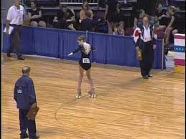
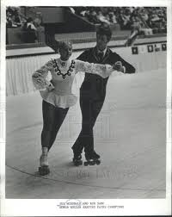
NEW Judges Structure
At the beginning, Judges needed to know all aspects of Figure Roller Skating that included the following:
Compulsory Figures
Compulsory Loops – Junior and Senior level only
Team Dance
Freeskating, Pairs, and Fours
All Judges were required to learn and understand each of these aspects to judge any contest, from local contests, all the way to the National Championships, and sometimes the World Championships.

Slide 18
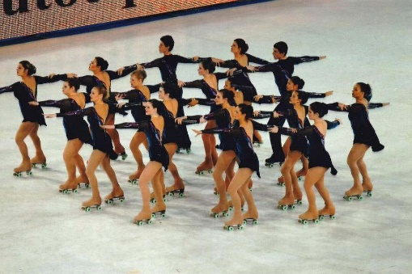
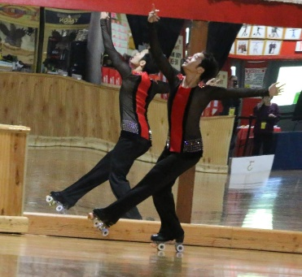
NOW, our Judges are expecting to learn and be proficient in the following events:
Compulsory Figures
Compulsory Loops – all levels, from Primary to Elite
Team Dance – Domestic, International, and Freedance
Solo Dance – Domestic, International, and Freedance
Creative Solo Dance
Quartets – Youth, Open, Elite
Precision – Junior, Senior, and Novice
Show – both large and small
Inline Solo Dance
Inline Freeskating
Freeskating and Pairs

Slide 19
The learning curve is so much greater and the skaters that we attempt to recruit, are also more specialized in their skating, as many no longer skate all disciplines. In discussions with skaters and new Judges, the question was, “would you judge more if you could judge the events you were trained on, versus having to learn and judge ALL events. The Dance athletes said it would be much easier to not learn all the jumps and spins and focus on dance and conversely, the Freeskating athletes had very strong opinions on how it would be easier if they didn’t have to learn ALL those dances.
With the implementation of RollArt this season and will continue into future seasons, the testing for Judges has been split into Freeskating and Dance separately. Those that had the old CIPA commission will be grandfathered in. The proposal is to mirror the same learning and testing structure, with Figures as the base for both tests, but have separate Figure/Freeskating and Figure/Dance Commissions moving forward. Those that already have a C, B, or A commission will be grandfathered into the combined commissions, as described below.

Slide 20
C Commission – Figure/Freeskating
C Commission – Figure/Dance
C Commission – Combined (all inclusive)
B Commission – Figure/Freeskating
B Commission – Figure/Dance
B Commission – Combined (all inclusive)
A-Alternate Commission – Figure/Freeskating/Pairs
A-Alternate Commission – Figure/Dance
A-Alternate Commission – Combined (all inclusive)
A Commission – Figure/Freeskating/Pairs
A Commission – Figure/Dance
A Commission – Precision/Show/Quartets
A Commission – Combined (all inclusive)
World Skate Commission – Figure/Freeskating
World Skate Commission – Figure/Dance
World Skate Technical Caller Commission – Freeskating
World Skate Technical Caller - Dance
World Skate Technical Specialist - Pairs

Slide 21
The plan is to implement this on-line program into the 2019-2020 season. It would be the responsibility of the Officials Committee to create testing for A through C commissions and also the promotion and administration of this program, with FSC oversight. The intent is to recruit competitive dance skaters into the Figure/Dance and the Freestyle skaters into the Figure/Freeskating. We hope that many will sign up, knowing they don’t need to train on all aspects of skating, but can focus on the skating they know and are comfortable with. Additionally, Meet Directors can schedule the Judges in the correct areas of expertise, not scheduling “dance” judges on Freeskating and vice versa.
Implementation of this program should increase the number of Judges that are desperately needed and can increase the quality of judging, using the skill sets of these volunteers, in the correct events.

Slide 22
COACHES AND JUDGES TRAINING
SEMINARS – Large and/or small
Webinars
Online training and testing
NATIONALS?

