Slide 1
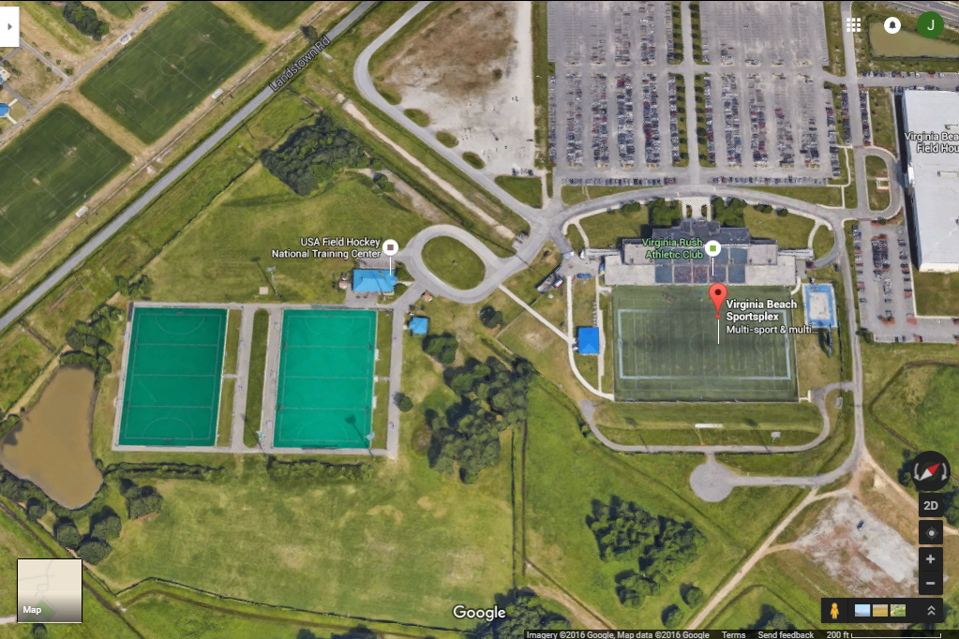
Umpire Hospitality:
Hydration Station 1+2
USAFH Tent #1/Results
Hydration Station 3
USAFH Tent #2
4U Sports
OPS
Field 1
Field 3
Field 5
Field 6
Public Shade Tent
Field 2
Field 4
Medical Tent 2
Medical Tent 1

